Slide 1
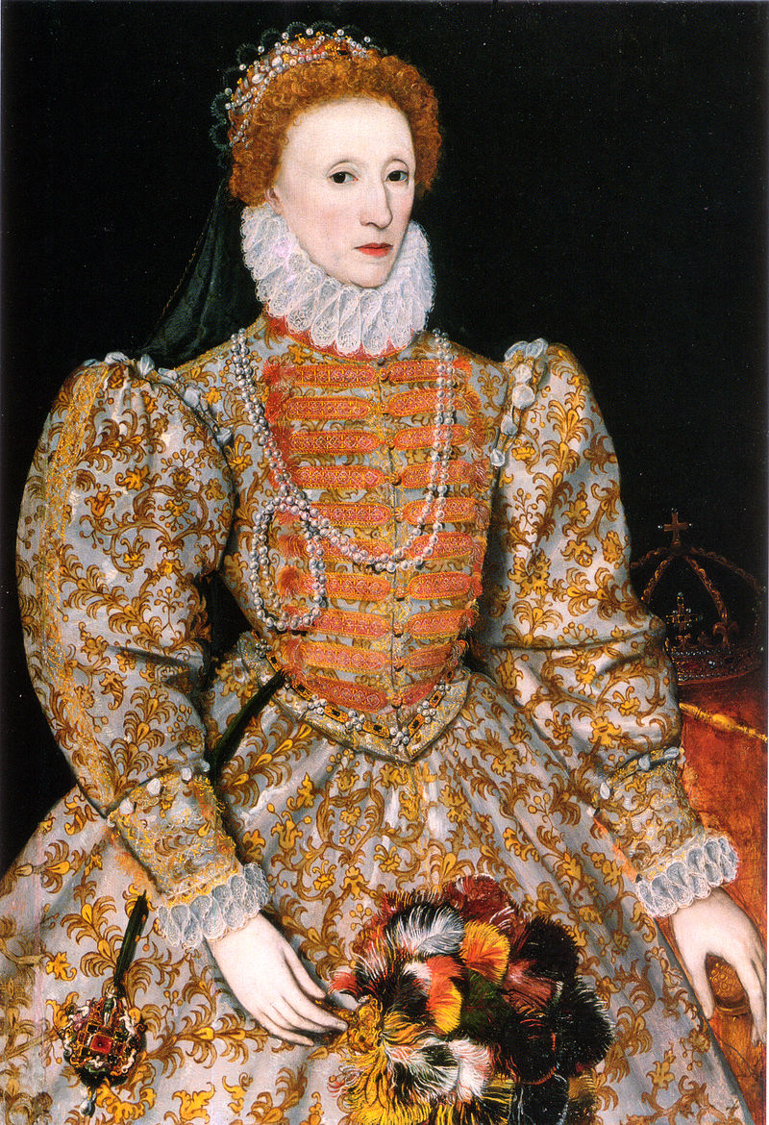
The Elizabethan Era (1558-1603)
A Golden Age
Historical Background

Slide 2
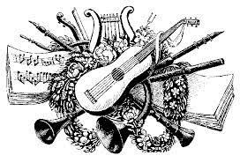
Relative peace and prosperity
Protestant Reformation established; less religious persecution.
Flowering of art, music, literature, theatre
Women: More freedom and education than in Europe
Exploration and discovery:
Raids on Spanish treasure ships;
1584 founding of Roanoke colony in VA;
1588 Spanish armada defeated

Slide 3
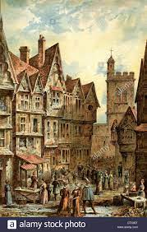
Urban Life
Poor sanitation
Crowded
Recurring plagues
London: Population increases
Average life span 42 years

Slide 4
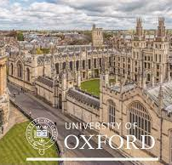
Education
Literacy: 80% in London (less elsewhere)
Grammar schools (long days)
Tutors for the wealthy
Cambridge & Oxford Universities
Emphasis on rhetoric:
Textbook listed 100 figures of speech
Variety rather than succinctness (Erasmus v Strunk & White)
.

Slide 5
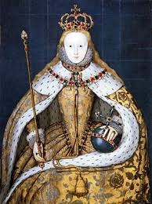
The Court
Stronger central government / monarchy
Less emphasis on war
Skills required for court life:
good manners and grace
literacy
courtly behavior

Slide 6
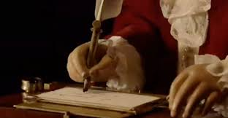
Sonnets circulated in court
Sonnets: Shared in manuscript:
among friends and members of court
Sonnets: A display of writers’ skills
Sonnets: A display courtly qualities:
balance
verbal facility and wit
following rules with grace

Slide 7
Love, Courtly Love and the Sonnet
Marriages
Arranged
Preserve wealth and power.
‘Courtly love’: Medieval European tradition
Little to do with real life
Well known to the Elizabethans
Stereotypical literary conventions
Sir Walter Raleigh
Courtier, Soldier, Explorer, Sonneteer

Slide 8
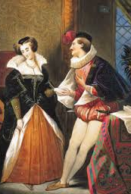
Courtly love poetic conventions
Married women:
Must reject the man’s advances to preserve her honor
Must show coldness towards the suitor
Male suitor:
Consumed with passion for an unattainable love
Writes poetry about his feelings of desire and rejection
Consumed with sadness
Cannot eat or sleep
Suffers jealous thoughts
Can never have enough attention from his beloved.
The subject of these poems:
The nature of true love
The poet, himself, or the person a of the poet.

Slide 9
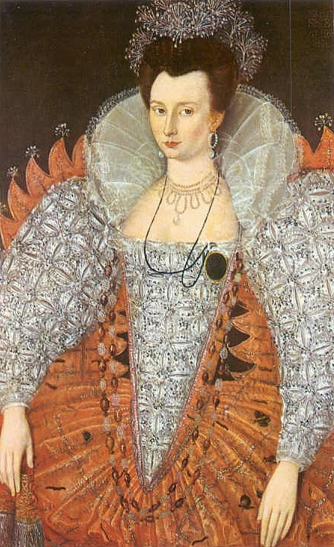
Elizabethan sonnets
4000 sonnets between 1580—1600
Clichés abounded:
The poet burns with icy fire
The woman’s teeth are like pearls
Her lips like cherries
Her eyes like suns or stars
Her neck milk-white
Her breath balm, amber and musk

Slide 10
Quick review of sonnet structure
14 lines; subject traditionally love
Petrarchan / Italian:
Octave and sestet
Volta: Turn at end of 8th line
English / Elizabethan / Shakespearean:
3 quatrains
Volta: Turn in the final couplet
Epigrammatic.

Slide 11
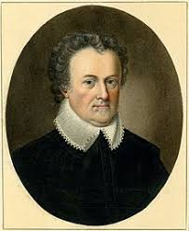
Michael Drayton 1563–1631
Secretary or steward to nobles
Friends with Shakespeare and Jonson
Humanist
Duty of the poet: Spokesperson for public values
Poetic works:
Historical epics
Didactic poems
63 sonnets
Sonnet sequence: Idea’s Mirror,
Playwright and satirist

Slide 12
Questions for Drayton’s Sonnet #61 (p. 35)
Did you enjoy this sonnet? What makes it enjoyable?
What is the mood of the speaker? Is he the typical suffering lover of the courtly love tradition?
What about the woman? What do we learn about her?
What is the tone of the first 8 lines (2 quatrains)?
Where is the volta, the turn? How does the poem’s meter and language signal the turn?
What is the dramatic action starting at line 9?
What about the ending? What happens in the couplet?
Is this a Petrarchan or an English (Elizabethan / Shakespearean) sonnet?
This is Drayton’s most (only) anthologized sonnet, to this day. What makes it timeless?

