Slide 1
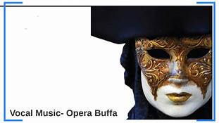
DON PASQUALE: Opera buffa & Commedia dell’arte

Slide 2
Opera Buffa
Emerged as a genre in Italy in the first half of the 18th century (contrasted with opera seria)
First used as an informal description of Italian comic operas (commedia in musica, dramma comico, divertimento giocoso)
First appeared between acts of opera seria
By 1750, opera buffa outnumbered opera seria
Not exclusively comic—mixture of comedy and pathos

Slide 3
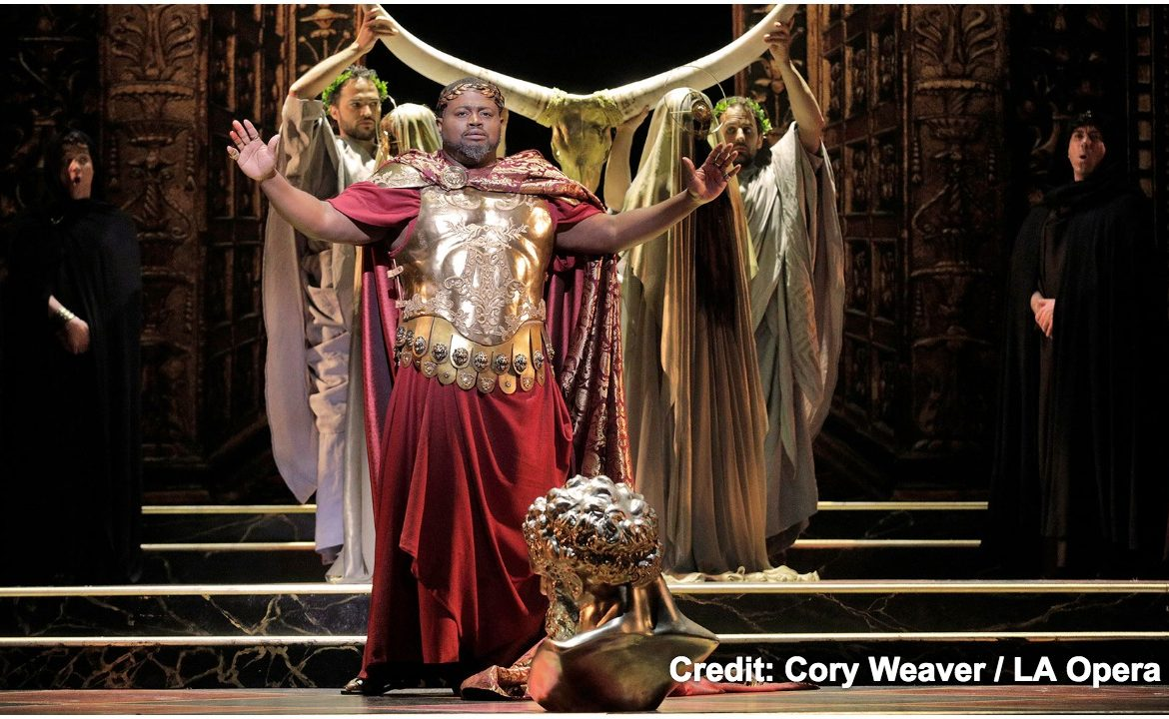
Role of Parody
Ridiculed the conventions of opera seria:
Excesses
Absurdities
Pretensions
Notes:
Stilted
Focused on gods
Static
Overblown
Role of castrati

Slide 4
Characteristics
Common people as characters (contrasted with heroes of ancient myth, gods)
Often spoken dialogue or simple keyboard-accompaniment
Sparkling overture
Wider range of voice types
Patter, Ensemble numbers/finales
Stock characters
Notes:
Ensemble movement and large scale finales, “servant and aristocrats could mix together musically in a way that challenged old divisions and hierarchies.”

Slide 5
Outstanding Examples
Mozart
The Marriage of Figaro
Don Giovanni
Cosi Fan Tutte
Rossini
Barber of Seville
Le Comte Ory
Donizetti
L’Elisir d’Amore

Slide 6
Commedia dell’Arte
16th Century Italy
Characterized by masked “types”
Stock Characters
Clowns (Zanni)—servants: sly, alert, sharp
Villains (Vecchi)—old men, proud, powerful
Lovers (Innamorati)—in love with each other (and themselves), self-obsessed, selfish
Crude physical humor
Exaggerated for Comic Effect
Notes:
Crude physical humor

Slide 7
Commedia dell’arte
Employed women as actors
Plays were both scripted and improvised
Often performed outdoors on platforms or in piazzas
Traveled throughout Europe
Plots set in the present day
Inspired later playwrights, such as Molière, and opera buffa (Rossini, Verdi)
Notes:
“Plots were set in the present day, granting them the potential for direct social and cultural critique that opera seria’s distant heroes and heroines could only claim through allegory.”

Slide 8
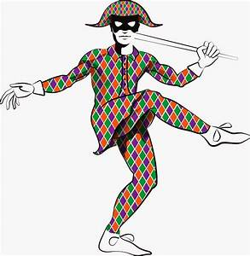
Arlecchino
Arlecchino (Harlequin)
Male Servant
Clown
Lives in the Present
Loves tricks and physical
antics
Seldom considers consequences
of his actions until it’s too late
Notes:
The word “slapstick” refers to Harlequin’s baton
Leporello, don Giovanni’s servant, is a “direct descendant” of Harlequin

Slide 9
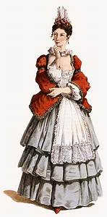
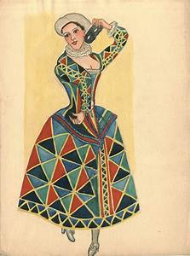
Columbina
Female Servant
Fresh, frisky, flirty
Not afraid to flaunt her
physical attributes
The smartest character in
a scenario

Slide 10
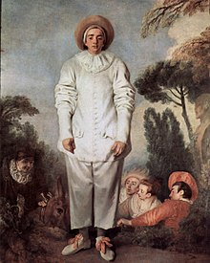
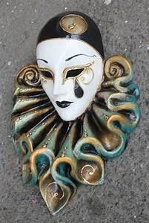
Pierrot
Sad clown
Pines for love of Columbina
Loses out to Arlequino

Slide 11
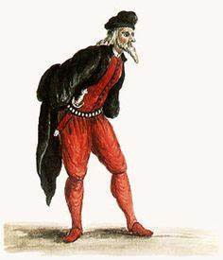
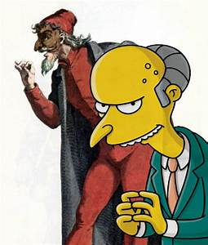
Pantalone
Old man, merchant
Miser
Professes poverty but is
obsessed about money
Lustful, lascivious
Thinks himself a master seducer
Usually gets duped in the end

Slide 12
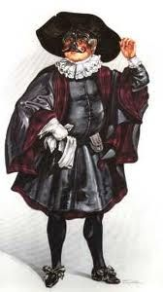
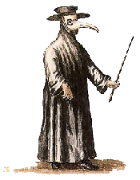
Il Dottore
A pedant
Professes to know everything
Loves to expound
A pretentious windbag

Slide 13
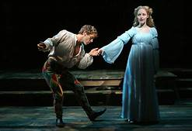
The Lovers
Romantic Leads
In their own world
In love with each other, and themselves
The only unmasked characters in the show
Notes:
Contrast between the old fashioned (marriage by arrangement) and the modern (falling in love)

Slide 14
Opera Buffa and Don Pasquale
Though opera buffa declined after 1840, Donizetti continued to write comic operas as well as serious ones.
Donizetti’s special contribution was to mix pathos and emotion with the farcical.
“As the music oscillates between the comic and sentimental, it encourages us to believe in the emotional capacity of the characters.”
Conventional to have characters point up the moral of the plot at the end of the opera.
Notes:
Conventional to have characters point up the moral of the plot at the end of the opera. We saw this in Don Giovanni. Norina does it at the end of Don Pasquale.

