Slide 1
Lorenzo Da Ponte: An Operatic Life (1749-1838)
Mozart’s Librettist

Slide 2
Lorenzo in his Youth

Slide 3
Early Career (1749-1773)
Born Emanuele Conegliano in Venice, Jewish by birth
Father converted to Roman Catholicism, married Catholic woman
Emanuele took the name Lorenzo Da Ponte from the bishop who baptised him
Attended 2 seminaries, became Professor of Literature, ordained a priest, 1773

Slide 4
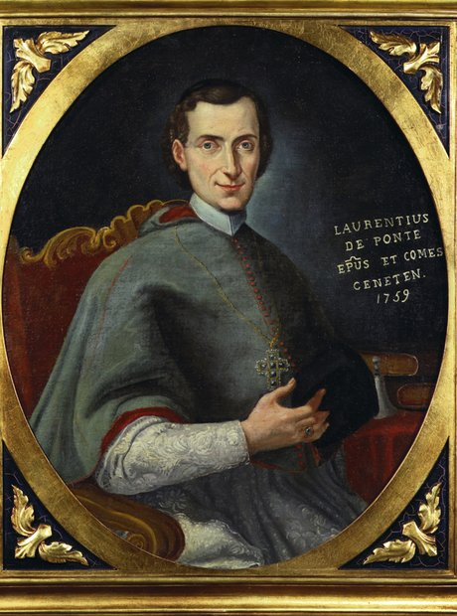

Slide 5
Venice, 1773-1779
Moved to Venice, taught Latin, Italian, French
Catholic priest led dissolute life– had mistress, 2 children
Charged with “public concubinage” & “abduction of a respectable woman”
Allegedly lived in a brothel, organized entertainment there
Trial– found guilty—banished for 15 years from Venice

Slide 6
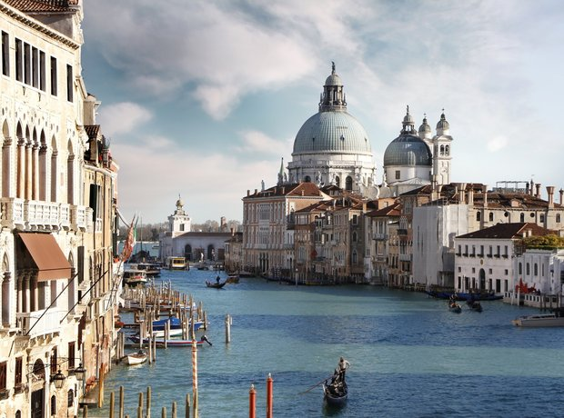

Slide 7
Vienna, London
Introduced to Antonio Salieri, collaborated with Mozart
Wrote libretti for Marriage of Figaro (1786),Don Giovanni (1787),Cosi fan tutte (1790)– all adaptations of pre-existing plots
London (1794-1805)—librettist at the King’s Theater, grocer, Italian teacher
Bankrupt– fled to United States

Slide 8
America (1805-1828)
Columbia College, first professor of Italian Literature, first Roman Catholic priest and first Jew on faculty
Produced first full US performance of Don Giovanni, NYC 1825
Naturalized US citizen, 1825
Founded Italian Opera House, predecessor of the Met Opera
Died in 1838, enormous funeral, St. Patrick’s Cathedral

Slide 9
Professorial Robes, Columbia College

Slide 10
New York's first professor of Italian literature

Slide 11
America's nascent opera company- 1833

Slide 12
Critical Response
Strengths: sharp characterization, humorous and satirical passages
Classified as Dramma giocoso (Italian, literally: drama with jokes), opera buffa (blends comedy, melodrama and supernatural elements.)
Portrayal of grand passions not his strength
Gustave Flaubert called Don Giovanni, along with Hamlet and the sea:
“the three finest things God ever made.”

Slide 13
1830

Slide 14
Sources
Tirso de Molina, El burlador de Sevilla, original Spanish tale, dates back 150 years
Countless puppet show versions
Moliere plays
Ballet by Gluck
The Stone Guest (earlier opera version of the tale) becomes DaPonte’s version of the tale The Rake Punished (Il dissoluto punito)

Slide 15
Evaluate Characterization—your view
DaPonte’s Life & Style

Slide 16
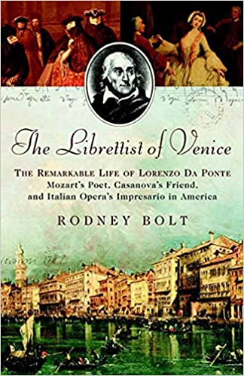

Slide 17
Evaluate Da Ponte—your view?
from the canals of Venice to the streets of New York
Da Ponte was at different times priest, professional gambler, proprietor of a bordello, passionate lover of many women,banned from Venice, political agitator, court poet, impresario, grocery store owner, and the first professor of Italian literature at Columbia University
Your view of Da Ponte? Bolt’s view (3)
How might Da Ponte’s own life be reflected in his view/portrayal of Don Giovanni?

Slide 18
Don Juan, Byron, Canto 1 (1818)
“Man’s love is of man’s life a thing apart, ’Tis woman’s whole existence; man may range The court, camp, church, the vessel, and the mart; Sword, gown, gain, glory, offer in exchange Pride, fame, ambition, to fill up his heart, And few there are whom these cannot estrange; Men have all these resources, we but one, To love again, and be again undone.”

Slide 19
Madamina, il catalogo è questo, aria,DaPonte
My dear lady, this is the list Of the beauties my master has loved, A list which I have compiled. Observe, read along with me
In Italy, six hundred and forty; In Germany, two hundred and thirty-one; A hundred in France; in Turkey, ninety-one; But in Spain already one thousand and three.

Slide 20
Among these are peasant girls, Maidservants, city girls, Countesses, baronesses, Marchionesses, princesses, Women of every rank, Every shape, every age. With blondes it is his habit To praise their kindness; In brunettes, their faithfulness; In the white-haired, their sweetness.

Slide 21
In winter he likes fat ones. In summer he likes thin ones. He calls the tall ones majestic. The little ones are always charming. He seduces the old ones For the pleasure of adding to the list. His greatest favourite Is the young beginner.

Slide 22
It doesn't matter if she's rich, Ugly or beautiful; If she wears a skirt, You know what he does.
Non si picca – se sia ricca, Se sia brutta, se sia bella; Purché porti la gonnella, Voi sapete quel che fa.

Slide 23
https://www.youtube.com/watch?v=7fuuD5hQwYw&ab_channel=HoustonGrandOpera

