Slide 1
DON CARLO
by Giuseppe Verdi

Slide 2
CHARACTERS
Philip II, King of Spain
Don Carlo, Crown Prince, Philip’s son
Elisabeth of Valois, daughter of the King of France
Rodrigo, Marquis of Posa, Don Carlo’s best friend
Princess Eboli, a lady of the Court, lady-in-waiting to Queen Elisabeth
The Grand Inquisitor, a priest, head of the Inquisition of the Catholic Church
Notes:
Elisabeth and Don Carlo are the same age

Slide 3
THE PLOT THICKENS
Act II ends with King Philip ordering Posa to spy on Carlo and Elisabeth, and warning him to beware the power of the Inquisitor.
In Act III, Princess Eboli suffers the humiliation of being spurned by Don Carlo and promises vengeance.
The Inquisition flexes its muscle as a crowd gathers in the square for an auto-da-fé.
Carlo pleads the Flemish case and draws his sword against his father.

Slide 4
Act IV
Philip, alone at night, suffers terribly as he recognizes that Elisabeth doesn’t love him.
He has Elisabeth’s jewelry box, in which she has kept Carlo’s portrait, and accuses her of adultery.
Eboli admits that she gave the jewelry box to the King in revenge, and says that Elisabeth is innocent.
The Grand Inquisitor confronts the King, threatening Carlo, Rodrigo, and even the King himself.
As Rodrigo tries to help Carlo, an agent of the Inquisition shoots Rodrigo.

Slide 5
ACT V
Elisabeth has come to meet Carlo one last time before he leaves for Flanders (at the tomb of the Holy Roman Emperor Charles V).
They are discovered by the Grand Inquisitor and the King.
As the agents of the Inquisition move in on Carlo, the Emperor himself is heard, saying that suffering is unavoidable and ceases only in heaven.

Slide 6
ROMANTIC PLOT LINE
Carlo & Elisabeth
Elisabeth & the King
Carlo—Elisabeth—Philip love triangle
Eboli—Carlo—Philip—Elisabeth
Notes:
Love vs. Duty
The personal vs. the political
Young woman, older man—does she love me? Can she love me?
Son vs. father

Slide 7
POLITICAL PLOT LINE
16th Century Spain
Spain controls much territory, including Flanders (modern-day Holland/Belgium)
Flanders wants its freedom, political and religious.
Rodrigo pleads the Flemish cause and gets Carlo to sign on
Is this idealism? treason?

Slide 8
RELIGIOUS PLOT LINE
Spain is a Catholic country.
The Inquisition, the Church’s arm against heresy, is in full force, burning heretics at the stake.
Flanders is a Protestant stronghold, making it rebellious in both the political and religious spheres.
The Inquisition will target anyone who supports the Flemish cause.
Notes:
Heretics are anyone that challenge the beliefs of the Catholic Church or its authority.

Slide 9
HISTORICAL BACKGROUND
Philip’s father was the Holy Roman Emperor, Charles V
At age 55, after periods of mania and depression, Charles abdicated the throne and retired to a monastery.
He divided the empire, giving his brother the Holy Roman Empire & central Europe
He gave his son Philip Spain, Burgundy (Holland, Flanders, part of France), Italy, & possessions in America
Notes:
Some of the action of the opera takes place at the tomb of Charles V and his voice is heard during the opera.

Slide 11
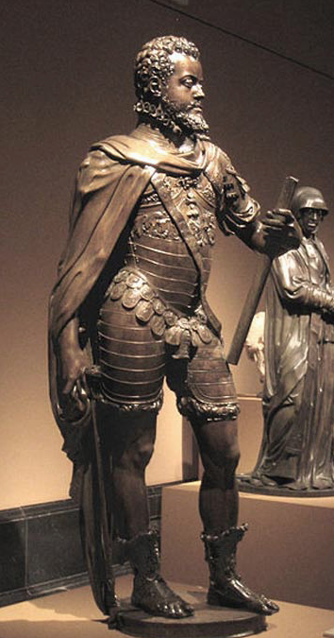
THE REAL PHILIP
1st wife died 2 days after Carlo’s birth
2nd wife was Mary Tudor.
After Mary’s death, Philip married Elisabeth de Valois, who bore him 2 daughters
After Elisabeth’s death, he married Anne of Austria (originally meant to marry Carlo), who gave him a male heir.

Slide 12
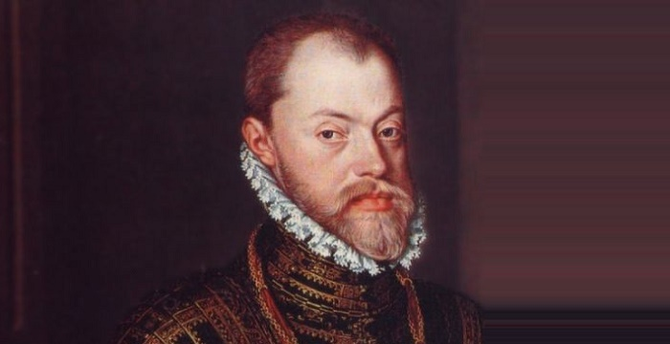
PHILIP AND CARLOS
Philip was an intolerant, severe man, suspicious of his son. Philip imprisoned Carlos and convened a secret trial to justify disinheriting him.

Slide 13
THE REAL CARLOS
Frail, backward (possibly “feebleminded”)
Physically weak
Hated and resented his father
Known to explode in anger
Selfish and arrogant
Undisciplined with women

Slide 14
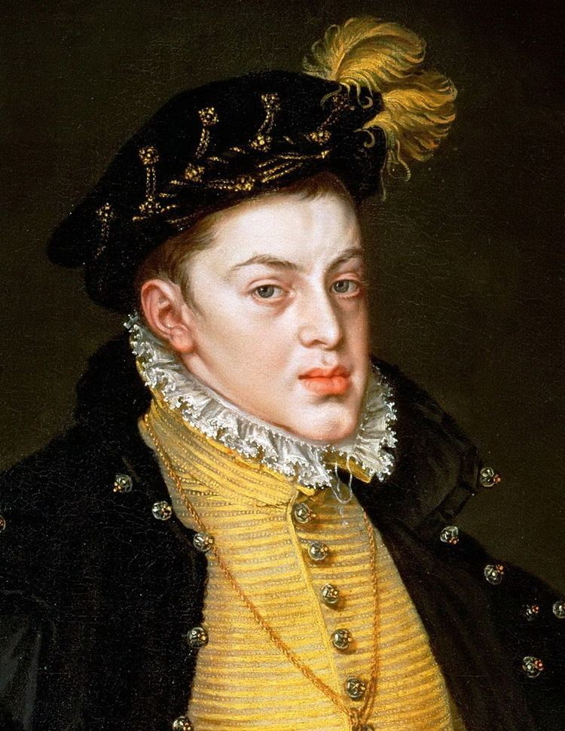
Died in prison—rumors of poisoning, but probably due to his binges of fasting & gluttony

Slide 15
THE REAL ELISABETH
Assimilated into Spanish culture
Refused to speak French
Adopted Spanish fashions
Dignified, devoted
Only member of Court to offer Carlos sympathy, understanding and friendship—became close friends. He wrote sonnets to her in French.
Died 3 months after Carlos—miscarriage. Philip was devastated.

Slide 16
ELISABETH DE VALOIS

Slide 17
THE REAL EBOLI
Anna de la Cerda y de Silva Cifuentes
Married off when she was 13 years old.
Always pictured with an eyepatch—may have been blind in one eye
Had 10 children, one of whom might have been Philip’s
After her husband’s death she spent 3 years in a convent, then returned to court
When she had an affair with Philip’s undersecretary of state, she was arrested and later died in prison

Slide 18
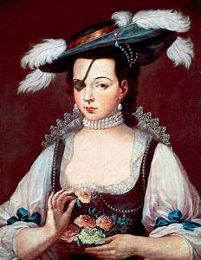
PRINCESS EBOLI

Slide 19
THE SPANISH INQUISITION
1478-1834
Established by Ferdinand & Isabella to maintain Catholic orthodoxy & transfer authority from the Pope to local authority figures.
Authorized trials of Christians suspected of secretly adhering to Islam or Judaism
“An eye that never slumbers”
Notes:
“The Inquisitors were royally appointed guardians who were vested with both civil and ecclesiastical power that exempted them from secular jurisdiction. Their proceedings were secret, and they arbitrarily confiscated the property of the condemned”—distributed to the Crown, the Inquisition or the accusers.

Slide 20
THE INQUISITION (cont.)
In 1481 the Inquisition introduced its trademark public event, the auto-da-fé. 6 alleged infidels were burned at the stake following a religious ceremony.
By 1530, the Inquisition is believed to have burned some 2,000 people alive, the vast majority of them Christians who had been born Jewish.
In the world of our opera (16th century Spain), religious coercion was a fact of life. Jews had already been pressured to convert or flee. Now the challenge came from the Protestant Reformation.
By the 19th century, the Inquisition had become the arch-symbol of religious intolerance and ecclesiastical power.

Slide 23
AUTO-DA-FE

Slide 24
FLEMISH REVOLT
Philip banned Protestantism in the Netherlands but could not force the Dutch to accept Catholicism.
Flemish revolt led to the 80 years war, beginning 1566.
Queen Elizabeth I supported the Dutch rebels. Defeated the Spanish Armada in 1588
Netherlands ultimately won independence from Spain and became a Protestant nation.

Slide 25
MEANING TO VERDI
Moved by the political sentiments in Schiller’s play
Anti-authoritarianism & anti-clericalism
King & Grand Inquisitor symbolize rigidity & intransigence
Passionate love of freedom and egalitarian ideals
Liberalism vs. absolutism
Outcry against tyranny, abuse of power
Notes:
Both the love affair and the desire to support Flanders underscored his attachment to freedom, personal liberty, the ideals of the Enlightenment.

