Slide 1
17th Century French Theater
COMEDIE FRANCAISE
Notes:
While Adriana Lecouvreur takes place in 1730 (18th century), it pays homage to the great period of Classical French Theater, the mid to late 17th century.

Slide 2
ADRIANA LECOUVREUR

Slide 3
King louis XIV
Notes:
We cannot even begin to discuss French cultural life in the 18th century without setting the stage—the court of King Louis XIV, “The Sun King”, Le Roi Soleil, king 1643-1715

Slide 4
The court at versailles
Notes:
In order to centralize his power and better control the nobility, Louis XIV moved his court to Versailles and forced all those who sought his favor to move there.

Slide 5
HALL OF MIRRORS

Slide 6
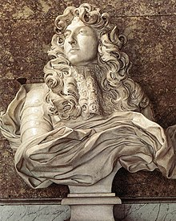
Patron of the arts
Painters
Sculptors
Composers, Musicians
Writers
Académie Francaise
Notes:
Commissioned work to glorify himself and his reign—buildings, public sculpture, paintings, music, plays and poetry
Collector--Bought enormous numbers of work of art—paintings, sculptures tapestries, furniture and furnishings. Royal commissions to artists. “He bought so many pieces of classical or Renaissance sculpture that Italy feared artistic denudation, and the Pope forbade the further export of art.”
Bust by Bernini
Loved ballet and frequently danced in them. (This is the origin of the tradition whereby French opera has to have a ballet in it) Jean-Baptiste Lully, Italian ballet master and composer--“music master of the royal family”
Created various Academies of the Arts: Fine Arts, Architecture
Academie Francaise ostensibly created to support the arts—also a very effective means of control
Imposed a “Classical Style”

Slide 7
Three giants
Pierre Corneille (1606-1684)
Jean Racine (1639-1699)
Jean Baptiste Poquelin (Molière) (1622-1673)

Slide 8
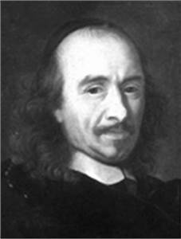
Pierre corneille
Considered the creator of French classical tragedy
Le Cid is considered his masterpiece
Notes:
Le Cid was labeled a “tragicomedy”
In later years Corneille conformed more closely to the conventions of classical genres—tragedy/comedy

Slide 9
Comédie francaise
Founded 1680 by royal decree (Louis XIV).
Oldest active theater company in the world
Its permanent theater is popularly known as “La Maison de Molière”—his troupe of actors were among the founding actors of the theater, set up a few years after his death.
Notes:
Acting Troupe and the name of the Theater
Comedie here has its largest meaning—implying all theater, comedy and tragedy

Slide 10
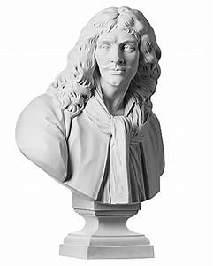
MOLIERE
Notes:
The bust of Moliere is on the stage at the very beginning of Adriana Lecouvreur. The historical Adriana performed at the Comedie Francaise theatre, so he hovers over the entire production

Slide 11
molière
Playwright, actor and poet. One of Louis XIV’s favorites
Theater troupe traveled the country performing both written and improvisational works. Characters based on Commedia dell’Arte
Comedies, including School for Wives, The Imaginary Invalid, Tartuffe, The Misanthropist, are still performed today
“Patron Saint” of French actors

Slide 12
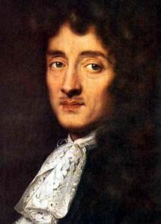
Jean racine
Great tragedies, many based on classical literature:
Andromaque
Iphigénie
Esther
Phèdre
Bajazet
Notes:
Bajazet, set in the Ottoman Empire, is the play being performed at the beginning of our opera

Slide 13
Alexandrin poetry
Rhymed couplets
12 syllables
Often with a break in the middle
Notes:
Writing known for its elegance and emotional impact.
His psychological insight is also notable

Slide 14
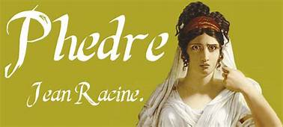
Phèdre
Phèdre is married to Theseus, but she is in love with her stepson Hippolytus
When Phèdre hears that her husband has been drowned, she confesses her love to Hippolytus, who does not reciprocate

Slide 15
Theseus, who is not dead, returns.
Phèdre is worried that Hippolytus will tell Theseus about her avowal of love.
Hippolytus, torn between his duty to his father and his love for another woman (not Phèdre), dies.
Phèdre takes poison and dies.

Slide 16
Adriana plays phèdre
At the end of Act III, all the characters of Adriana Lecouvreur are at a party
Adriana is asked to perform and chooses to recite Phèdre’s monologue, which she contorts to accuse the Princess of her love affair with Maurizio
“I know my evil crime,” Phèdre says, “I am not like those shameless women who delight in betrayal, whose icy brow will never blush!”

Slide 17
conclusion
Adriana, using all of her powers as an actress and Racine’s power as a poet, accuses and embarrasses the Princess
“Reckless woman, what have you done?” says Michonnet
“She’ll pay for this insult!” says the Princess
“I am avenged,” says Adriana.

Slide 18
THEATRICALITY
Theater troupe
A play within a play
Deliberate theatricality of plot, performance
A love letter to theater, acting, passion, opera
Notes:
The opera lover’s opera

