Slide 1
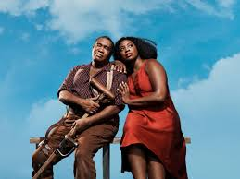
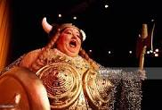
OPERA:
From A to Z

Slide 2
ANCESTRY
WHERE? WHEN? WHO?
First opera created in Florence, Italy in 1597 by the Florentine Camerata, a group that aimed to revive Greek drama using music.
WHAT?
The text was sung by one singer at a time, accompanied as simply as possible.
The music had to depict the emotions of the character who was singing

Slide 3
ANCESTRY (cont.)
WHO WATCHED IT?
Opera flourished throughout Europe at royal courts
First public opera house opened in Venice in 1637. Other cities followed soon after.
WHO WROTE IT?
The first great opera composer was Claudio Monteverdi (1567-1643)
His first opera, Orfeo (1607), is considered the first opera masterwork.

Slide 4
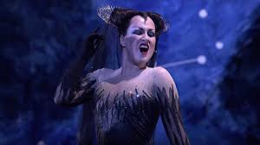
ARIA
Song for solo voice with instrumental accompaniment
In contrast to RECITATIVE—sung conversation, often with minimal accompaniment, which advances the plot.
Arias are associated with emotional expression.

Slide 5
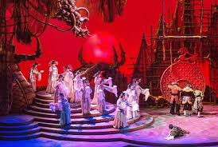
CHORUS
Vocal ensemble—townspeople, relatives, guards, who contribute and comment on the action of the plot
OR a piece of music for this ensemble.

Slide 6
LEITMOTIF
A short thematic musical passage representing a character or situation.
https://www.youtube.com/watch?v=-PkS2HQj9ZE/
“Jasmine flower” (or “The Mountains of the East”): sung by a children’s chorus Act I of Turandot and repeated several times during the opera.
Serves as a leitmotif for the Princess

Slide 7
LIBRETTO
“Little book”
The text of an opera.
Compare with the SCORE, the written music of an opera or other musical work
Mozart, Verdi and Richard Strauss had favorite librettists. Wagner and Berlioz, on the other hand, were their own librettists.

Slide 8
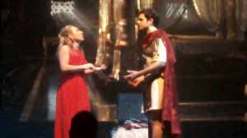
OPERA STYLES
OPERA SERIA
“Serious opera”
Dramatic and intense plots
Stories are often tragic and typically involve heroes and kings or ancient myths and gods
Especially popular in 18th c. Italian opera.
https://www.youtube.com/watch?v=afsItTKotHo
Agrippina (Handel)
Idomeneo (Mozart)

Slide 9
OPERA STYLES
OPERA BUFFA
“Funny opera”
Especially popular in 18th and early 19th century Italy.
Always sung in Italian
Jokesters are from the working class—maids, peasants, servants—who get the best of their employers
Developed the use of ensembles (duets, trios, act finales with many characters participating)
The Barber of Seville (Rossini)
The Marriage of Figaro (Mozart)
https://www.youtube.com/watch?v=Jrj2dLMIYKA

Slide 10
OPERA STYLES BEL CANTO
“Beautiful Song”
The art of Italian singing popular in 18th and early 19th centuries that emphasizes beautiful tone, masterful vocal technique (breath control and flexibility in singing loudly and softly), elegant phrasing.
Donizetti, Bellini and Rossini were among its best known composers
https://www.youtube.com/watch?v=P5y0YWX1VkU

Slide 11
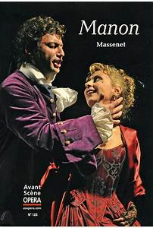
OPERA STYLES
OPERA COMIQUE
“Comic Opera”
Not necessarily funny
Originated in satirical parodies of grand opera
Some of the text is spoken, not sung
Flourished in 19th Century, especially France
Carmen (Bizet)
Manon (Massenet)

Slide 12
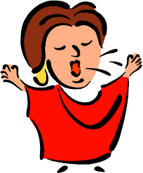
OPERA VOICES: FEMALE
Soprano
Highest female voice.
Can be lyric or dramatic.
Coloratura (“coloring”)—capable of agility, fast and high singing, trills and embellishments. Increases dramatic and emotional expressiveness
Mezzo Soprano
Between soprano and contralto.
Can be lyrical or dramatic.
Contralto
Lowest female voice
Often portrays comic, other-worldly or matronly roles

Slide 13
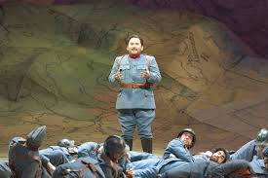
OPERA VOICES: MALE
Bass: Roles include kings, wizards, fathers, villains
Baritone: Can be expressive, lyrical or heroic
Tenor: Generally the hero, the lover
Countertenor: The highest male voice, sometimes in falsetto

Slide 14
COUNTERTENORS
A high male voice within the contralto & mezzo range (though the sound differs from his normal singing or speaking voice).
Until the 1830s, countertenors were often castratos, gifted male musicians who were castrated before puberty to maintain and develop their higher range.
Many male singers can reach the falsetto register that characterizes the countertenor; what makes a countertenor unique is that he can sustain it and sing expressively.
From a technical standpoint, countertenors produce their sound by vibrating only the tips of the vocal cords. When a tenor sings, 70 percent of his vocal cords close; when a countertenor sings, only about 10 percent close. Not surprisingly, it requires technical precision for a countertenor to generate power and volume.

Slide 15
THE VOICES
https://www.youtube.com/watch?v=hLfvkwTnJVM
Range: How low and how high the singers can go. The entire series of notes they can reach
Size: The ability to cut through an orchestra’s sound
Vibrato: The lightly fluctuating quality in a singer’s voice while sustaining a pitch. Good vibrato is used subtly as an accent rather than consistently throughout the entire aria.

Slide 16
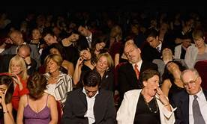
Zzzz. . . .
Opera lovers

Slide 17
