Slide 1
African American Poetry
Notes:
START WITH SOUND CHECK– RAISE YOUR THUMB IF YOU CAN HEAR ME AND HUGH WITHOUT THE HEAD SET.

Slide 2
Themes
Rampersad organizes his anthology thematically, including identity, slavery, history, racism, Africa, love in its various forms, tributes to leaders, and music
My presentation here is historical
NOTE: Racism: 1981- American Heritage Dictionary: “The notion that one’s own ethnic stock is superior.”
Racism: Https://www.merriam-webster.com/dictionary/racism --larger definition, including systemic racism
Notes:
A word about language

Slide 3
Some anthologies
1931 The book of American Negro Poetry ed James Weldon Johnson,
1925 The New Negro: Voices of the Harlem Renaissance, ed. Alain Locke,
1941 The Negro Caravan ed. Sterling Brown et al.
1968: Black Voices: An Anthology of Afro-American Literature.
1968: Black Fire: An Anthology of Afro-American Writing. Eds Baraka and Neal
1969: The New Black Poetry. Ed. Clarence Major
1985: The Black Poets. Ed. Dudley Randall
1998 Call and Response: The Riverside Anthology of the African American Literary Tradition ed. Patricia Liggins Hill et. Al, (includes a variety of literary forms in poetry and prose)
2005 The Oxford Anthology of African-American Poetry ed. Arnold Rampersad
Notes:
Anthologies– you can see the way that the names for black people have changed

Slide 4
How does poetry make meaning?
Poetry is compressed, leaves out the inessential
Poetry unearths the images, the metaphors and sensory experiences that are the foundations of language.
Poetry evokes rhythm, the sensuous content of words: feeling, imagination rather than fact
Poetry aims to evoke a kind of dream-state, “lucid dreaming” (Zapruder, Why Poetry)
Poetry subverts the patriarchal order through rhythm and non-idiomatic usage (Julia Kristeva, Revolution in Poetic Language)
Poetry works by “defamiliarization”
Poetry moves by leaps, associations, connections
Notes:
But not all poetry meets each of those categories and fits neatly into that framework. Many of these features occur in African American poetry as well, BUT there is often a different emphasis. Before we review some of the history of African American poetry let’s talk for a bit ABOUT POLITICAL POETRY.

Slide 5
Political Poetry
Much of African American poetry is political poetry.
Political poetry has a long tradition, going back to the prophets of the Hebrew Bible.
All poets face the question of audience– for whom are they writing?
For African American poets that question becomes: are they writing for white people or for black people? Can poetry address both audiences?
And what message will their poems convey?
Notes:
There are at least two prominent strands of political thinking among African Americans. One of these strands– maintained most notably by Booker T. Washington advocates practical job training, being good citizens, finding jobs, behaving well. The other strand is one favored by W.E.B. DuBois, Martin Luther King, Jr., and now by Black Lives Matter: demand your rights. DUDLEY RANDALL ENCAPSULATED THE CONTRASTING PHILOSOSPHIES OF WASHINGTON AND DUBOIS IN A POEM.

Slide 6
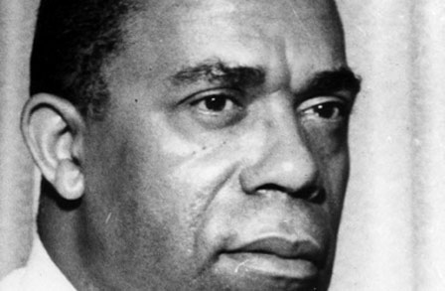
Dudley Randall (1914-2000): His poem sums up the basic philosophy of two important black leaders with different approaches
https://www.poetryfoundation.org/poems/47690/booker-t-and-web
Booker T. Washington (1856 – 1915)
First principal of Tuskegee Institute
W. E. B. DuBois (1868-1963)
Founded NAACP
Wrote The Souls of Black Folk
Notes:
Both Booker T Washington (1856-1915- and WEB DuBois (1868-1963) -were important leaders. But the story of African American poetry BEGINS IN EARLIER TIMES.

Slide 7
* Early African-American poetic tradition
Captive people abducted from Africa and enslaved in the North American colonies brought with them a rich poetic tradition that included oral epics, the griot historical recitations, and work songs.
Written models of African origin were lacking; therefore African American oral and written literary productions followed European and biblical models
First group of poets were enslaved; freedom was a primary theme
Notes:
Early African-American poetic tradition The first 20 Africans were brought to the colony of Virginia in 1619. There they became indentured servants. The indenture mutated into the unique chattel slavery system of the colonies. Enslaved people were not legally allowed to read and write; the field work in the Southern colonies was difficult; and whatever literary expression was chiefly oral== included songs, chants, gospel songs and oratory, lullabies, riddles, folk tales.
The use of European and biblical models made it possible for African American oral and written productions to reach both white and black audiences..

Slide 8
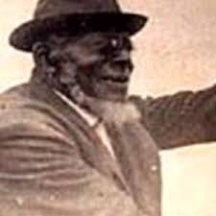
ENSLAVED POETS Jupiter Hammon (1711-1806?)
Hammon was the forefather of African American poetry, the first African American enslaved person to publish a written poem: “An Evening Thought: Salvation by Christ” in 1760. Held by the Lloyd family (Lloyd’s of London)
His poems contained coded messages couched in religious terms to speak to African Americans. His first poem starts:
“Salvation comes by Jesus Christ alone / the only Son of God;
Redemption now to every one, / that love his holy Word.”
Notes:
Few Black women were brought to the Northern colonies: Hammon did not marry. Because the economy of the Northern colonies was oriented toward business, enslaved people in these colonies were often literate in order to work in the businesses. Hammon was a clerk.
When I looked for an image of Jupiter Hammon, I found the image also ascribed to Paul Laurence dunbar. He was born in Long Island, NY and was enslaved in the Lloyd family, a shipping and slave-trading concern that evolved into Lloyds of London.

Slide 9
Other enslaved poets Lucy Terry (1730-1821) Lemuel Haynes (1753-1833) George Moses Horton (1797-1883)
"The Battle of Lexington": A Patriotic Ballad by Lemuel Haynes
“Bars Fight” by Lucy Terry (written in 1746; published 1895)
“On Lliberty and Slavery” by George Moses Horton
Horton hired himself out as a janitor at Univ. of N. Carolina; composed poems for students for a fee (first orally; then in writing)
Notes:
Lemuel Haynes

Slide 10
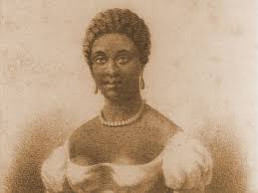
Phillis Wheatley (1753?-1784)
Abducted from West Africa when she was 5 or 6 years old
She was purchased by John and Susannah Wheatley of Boston
When she was 18 (in 1773) the Wheatleys sent her to London to publish her first volume of poetry and to get medical care.
https://www.poetryfoundation.org/poems/45465/on-being-brought-from-africa-to-america
Followed English models of poetry
Notes:
The Wheatleys recognized Phillis’s precocity and educated her, She studied the Bible, astronomy, geography, history, British literature (particularly John Milton and Alexander Pope), and the Greek and Latin classics of Virgil, Ovid, Terence, and Homer. In “To the University of Cambridge in New England” (probably the first poem she wrote but not published until 1773), Wheatley indicated that despite this exposure, rich and unusual for an American slave, her spirit yearned for the intellectual challenge of a more academic atmosphere.People in England were more willing to help her publish her poetry. In London she met leading abolitionists and Benjamin Franklin.. She was celebrated in England. Shortly after she returned to Boston she was freed. She later married, but the family struggled to support itself during this time of economic disruption. STOP SLIDE SHOW AND TALK ABOUT WHEATLEY’S POEM
Life was difficult for free blacks because of discrimination and difficulty of getting employment– this is a recurring struggle in times of economic downturn. Her emphasis on religion may seem to downplay the problem of enslavement, but in the 18th century the church was a powerful institution, and the chief organization that would support abolition. Notice the last 2 lines of this poem– she’s calling Christians to account for their attitude toward Negroes .

Slide 11
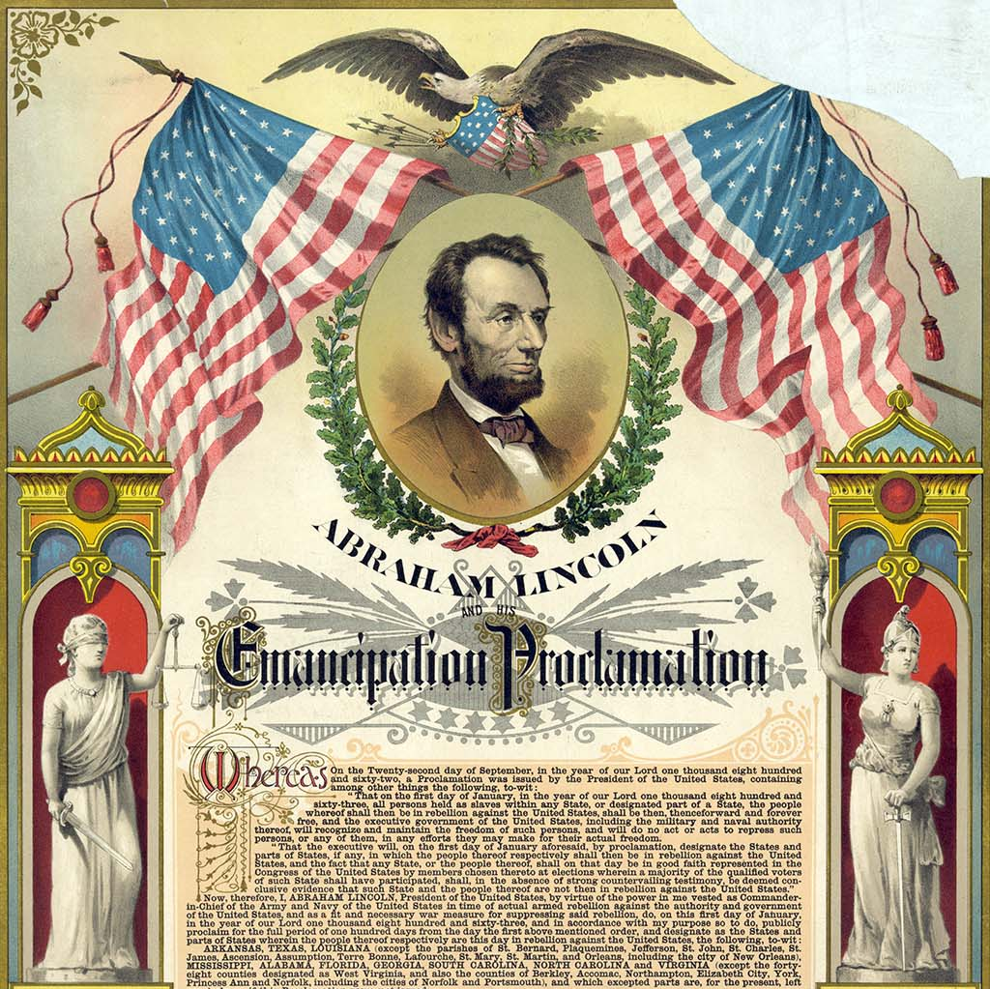
Post slavery
Themes of equality continue. New themes include African American life; women’s rights; a range of personal feelings and ideas, etc.

Slide 12
Frances Watkins Harper (1824-1911)
https://www.poetryfoundation.org/poems/52449/a-double-standard
“poet, fiction writer, journalist, and activist “ abolitionist, wrote about race, religion, and reform.
Notes:
Frances Watkins Harper co-founder and vice president of the National Association of Colored Women, and a member of the American Women’s Suffrage Association. Harper was also the director of the American Association of Colored Youth.

Slide 13
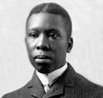
Paul Lawrence Dunbar (1872-1906)
He worked as an elevator operator; then patrons helped him devote himself to his writing.
He wrote poems in dialect and standard English; but won more recognition for his dialect verse with its “happy darky” stereotypes.
“We Wear the Mask” (p. 107 in our book chapter 5 )
https://www.youtube.com/watch?v=jDwgnWE6jW8
Notes:
Paul Lawrence Dunbar

Slide 14
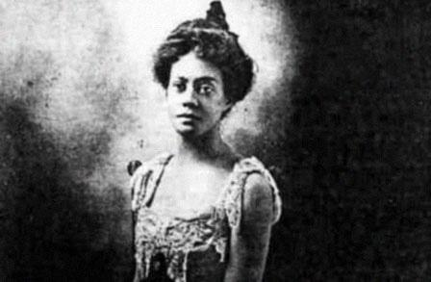
*Alice Dunbar Nelson (1875-1935)
Paul Dunbar was her first husband; Robert Nelson her third
She wrote fiction, taught in elementary schools, and wrote newspaper columns
https://poets.org/poem/sonnet-0
https://poets.org/poem/i-sit-and-sew
Notes:
Alice dunbar nelson: Paul Dunbar saw her picture printed with one of her poems and fell in love. They corresponded and he proposed marriage when they met in person. The marriage lasted 4 years.

Slide 15
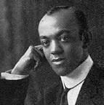
Fenton Johnson (1888-1958)
https://www.poetryfoundation.org/poems/150665/tired
(p. 114 in our book chapter 5)
Notes:
Fenton Johnson

Slide 16
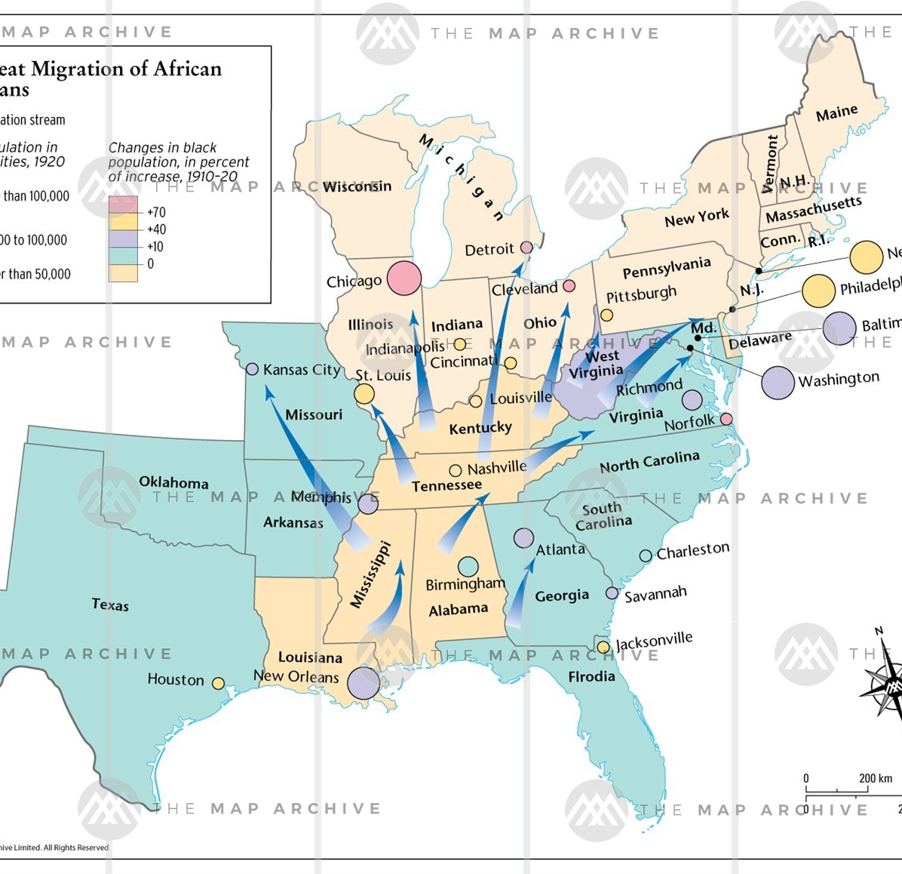
*Great Migration 1915-1945
Notes:
Great Migration 1915-1945 WWI led to a labor shortage in the US; blacks migrated north in hopes of better opportunities. QUEUE THE LAWRENCE UP BEFORE THE CLASS STARTS

Slide 17
Jacob Lawrence (1917-2000) Migration Series

Slide 18
*Harlem Renaissance 1915-1945
Rich cultural milieu: Influence of folk culture, poets on musicians and vice versa
Jazz, boogie-woogie, blues, gospel music—Duke Ellington, Bessie Smith, “Ma” Rainey, Billie Holiday
Race riots, lynching, Great Depression
W.E.B. DuBois founded NAACP in 1909 and was founding editor of The Crisis in 1910
1913 Opportunity founded by the Urban League, first editor Charles S. Johnson
Debates over the function of African American art: art v social protest
Notes:
Harlem Renaissance 1915-1945 Chicago race riots in 1919. “Red summer” Soldiers returning from WWI blamed African Americans for taking the jobs. 23 Blacks and 15 whites died during a week of violence.

Slide 19
Thomas Dorsey (1899-1993)
“Take My Hand, Precious Lord” written in 1932, after death of his pregnant wife
https://www.youtube.com/watch?v=as1rsZenwNc (Mahalia Jackson sings it)
Notes:
This is a different Tommy Dorsey than the white band leader.

Slide 20
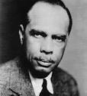
James Weldon Johnson (1871 – 1938)
https://www.poetryfoundation.org/poems/46549/lift-every-voice-and-sing
https://www.youtube.com/watch?v=8QK4p22LHtw
(p. 357 in our book chapter 15 “Lift Ev’ry voice and Sing”)
Notes:
James Weldon Johnson was a major figure; compiled anthologies

Slide 21
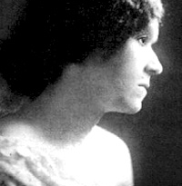
Georgia Douglas Johnson (1880-1966)
https://www.poetryfoundation.org/poems/52494/the-heart-of-a-woman
Her home became the gathering place for Harlem Renaissance writers in Washington DC
She published 4 books of poetry
(“Motherhood” is on p. 239 in our book chapter 10 “Children”)
Notes:
Georgia Douglas Johnson

Slide 22
Anne Spencer (1882-1975)
Notes:
Anne spencer: women did not have as much access to publishing as men

Slide 23
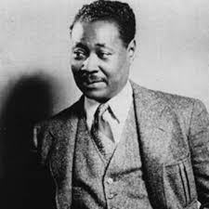
*Claude McKay (1889-1948)
Born in Jamaica, moved to the US, then traveled widely in Europe from 1923-34.
He wrote his most famous poem “If We Must Die” during the Chicago race riots (1919). He was a train waiter on the Pennsylvania Railroad. He writes that the train staff carried revolvers and stayed together for protection.
https://www.poetryfoundation.org/poems/44694/if-we-must-die (p. 115 in our book chapter 5)
https://www.poetryfoundation.org/podcasts/76739/constrained-to-honor-a-discussion-of-claude-mckays-if-we-must-die (McKay reads)
https://www.poetryfoundation.org/poems/44697/the-tropics-in-new-york
Notes:
McKay: “Bitterness is a natural part of the black man’s birthright…. OUT of bitterness he has bloomed and created the spirituals and blues and conserved …his humor and laughter and particular rhythm of life.” Protest poem in sonnet form. Who is addressed: black readers and white readers as well. Uses the sonnet form– of the white English Shakespearean tradition. There is an urban legend, undocumented, that Winston Churchill read the “If We Must Die” in the legislature during WWII.

Slide 24
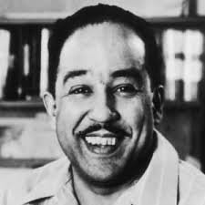
Langston Hughes (1901-1967)
“I dream a world” https://allpoetry.com/I-Dream-A-World
Read at John Lewis’s funeral July 30, 2020. (p. 355 in our book chapter 15 “I Dream a World”)
“Harlem” https://www.poetryfoundation.org/poems/46548/harlem
“Rivers” https://poets.org/poem/negro-speaks-rivers
(p. 73 in our book chapter 4 “Like Walking out of Shadow”)
Notes:
Poetry foundation: he was the first black American to earn his living solely from his writing and public lectures. Hughes, more than any other black poet or writer, recorded faithfully the nuances of black life and its frustrations., Hughes composed “Rivers” when he was traveling to visit his father & the train crossed the Mississippi River. It was read at his funeral service. “The black man has drunk of their life-giving essences, and thereby borrowed their immortality.”
Death is one of the main themes in the poem, although it is subtle. Critic Arnold Rampersad writes:
With its allusions to deep dusky rivers, the setting sun, sleep, and the soul, [the poem] is suffused with the image of death and, simultaneously, the idea of deathlessness. As in Whitman's philosophy, only the knowledge of death can bring the primal spark of poetry and life. Here Langston Hughes became ‘the outsetting bard,’ in Whitman's phrase, the poet who sings of life because at last he has known death.
Prose: Jess B. Semple, a folk character – very popular.

Slide 25
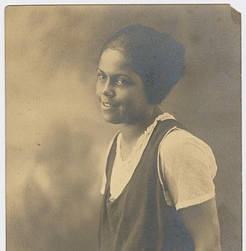
Gwendolyn Bennett (1902-1981)
Artist as well as poet & prose writer.
https://poets.org/poem/dark-girl
http://www.ctadams.com/gwendolynbennett2.html
Notes:
While attending Girls' High in Brooklyn, NY, Bennett was awarded first place in a school wide art contest, and was the first African-American to join the literary and dramatic societies. She wrote her high school play and was also featured as an actress. She also wrote both the class graduation speech and the words to the graduation song. She taught at Howard University from 1924-1927, forced to resign when she married. She worked for the Federal Writers Project and Federal Arts Project, but was suspended “on suspicion of Communist connections” in 1941. She then worked “anonymously” as a secretary for Consumers Union.

Slide 26
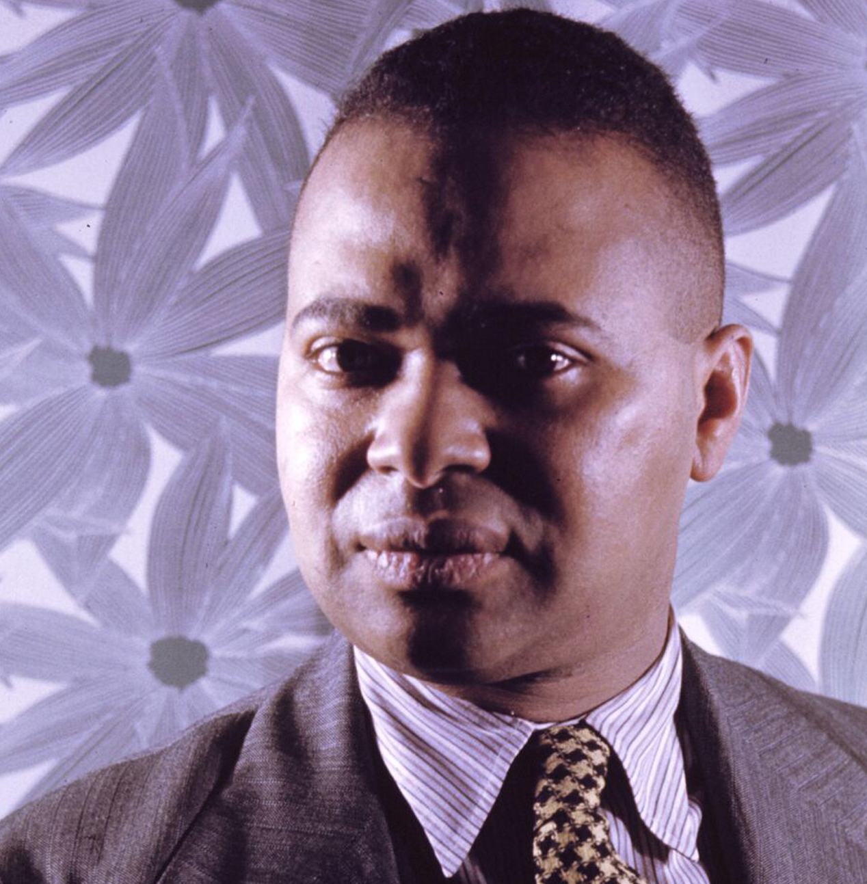
Countée Cullen (ne Porter) (1903-1946)
Heritage
What is Africa to me:
Copper sun or scarlet sea,
Jungle star or jungle track,
Strong bronzed men, or regal black
Women from whose loins I sprang
When the birds of Eden sang?
One three centuries removed
From the scenes his fathers loved,
Spicy grove, cinnamon tree,
What is Africa to me?
. . . . . .
Graduated from DeWitt Clinton HS in NY, and Phi Beta Kappa from NYU. MA from Harvard 1926.
Published his first book, Color, when he graduated.
He advised Black writers to follow white European and American traditions, rather than African.
He wrote sonnets, some of which we’ll see next week!
Notes:
Declined offers to teach in Southern Colleges, remained in Harlem. Raised by his grandmother after his parents died. When grandma died he was adopted by Rev. Frederick A. Cullen of the Salem African Methodist Episcopal Church in Harlem. In 1928 he married Nina Yolande DuBois, the daughter of W. E. B. DuBois, AND he received a Guggenheim Fellowship to write poetry in France. Although he advocated a universal model for poetry, rather than an ethnic one, his best poems foreground African American traditions.

Slide 27
Helene Johnson (1906—1995)
http://www.ctadams.com/helenejohnson5.html
“Magalu”
Johnson was born in Boston. Never saw her father; was told he was Greek. Her mother worked as a “domestic.”
Notes:
Johnson was well known during the Harlem Ren. Her cousin was the writer Dorothy West. The 2 moved to NY together in the 1920s. She married William Hubbell in 1933 and had a daughter Abigail. She won 2nd prize in several poetry contests sponsored by the important African American literary magazines, published widely in the magazines.

Slide 28
The Post-war period 1945-1960
1954
Brown v Board of Education ends legal school segregation (Thurgood Marshall was the lawyer for Brown)
1955
Emmett Till’s murder
1955
Montgomery, AL Bus Boycott (Rosa Parks)
1960
lunch counter sit-ins (SNCC founded)
Notes:
The Post-war period 1945-1960

Slide 29
Male poets of the post-war period
Owen Dodson
Robert Hayden
Dudley Randall
Melvin Tolson
Notes:
Male post-war poets

Slide 30
Women poets of the post-war period
Gwendolyn Brooks
Margaret Danner
Naomi Madgett
Pauli Murray
Gloria C. Oden
Margaret Walker
Rita Dove
Notes:
Women post-=war poets

Slide 31
Black Arts Movement
Anthology: Black Fire eds. Amiri Baraka and Larry Neal 1968
Emphasis on African and African-American cultural history
Art for the people (rather than art for art’s sake)
Notes:
Black Arts Movement

Slide 32
1960s Civil Rights Activism-- chronology
1963 Freedom March on Washington– “I have a dream” (powerful prose)
1965 Assassination of Malcolm X
1965 Voting Rights Act
1966 Black Panther Party founded
1968 Assassination of Martin Luther King, Jr.
2008, 2012 President Barack Obama
2019--- Black Lives Matter
Notes:
1960s Civil Rights Activism. Conflict between the separationism of Malcom X and the non-violent integration of Martin Luther King.

Slide 33
Black arts poets
Amiri Baraka
Haki Madhubuti
Clarence Major
Eugene Perkins
Lorenzo Thomas
Conrad Kent Rivers
Gil Scott-Heron
Sonia Sanchez
Carolyn Rodgers
Nikki Giovanni
Lucille Clifton
Jayne Cortez
Sarah Webster Fabio
Notes:
Black arts poets

Slide 34
Rap
Associated with hip-hop, rap is spoken rhythmically (chanted) to a music background, featuring a 4-beat line.
Some of the major American rappers : Lil Jon, Ice Cube, Dr. Dre, Grandmaster Flash, the Beastie Boys and Tupac Shakur.
John Wideman writes that rap music is an “incan[ta]tory use of the word to name, blame, shame, and summon power, the obligation of ritual to instruct and enthuse.”
Notes:
Rap derives from the West African griot tradition. Griots retell oral history or genealogy, usually to drums.
Some influences on rap are negro spirituals, work songs, jazz, and the blues.

Slide 35
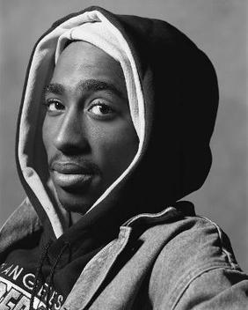
Rap: Tupac Shakur born Lesane Parish Crooks (1971-1996)
http://ohhla.com/anonymous/2_pac/the_lost/panther.2pc.txt
https://www.youtube.com/watch?v=OoroT-M2G0I
“Much of Shakur's work has been noted for addressing contemporary social issues that plagued inner cities, and he is considered a symbol of resistance and activism against inequality.^{[7]”}
Wikipedia
Notes:
Tupac Shakur

Slide 36
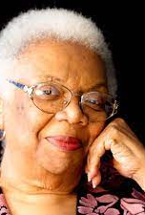
Lucille Clifton (1936—2010)
Her parents were poets and story tellers
Attended Howard University and Fredonia State Teachers College
Married Fred Clifton, Philosophy Professor at University of Buffalo; parented 6 children
“big ideas in simple language”
1969 Good Times: Poems
1979 poet laureate of Maryland
1985 Professor, University of California at Stanta Cruz
“Homage to my Hips”
“https://vimeo.com/36987057 Homage to my Hips”
Notes:
Lucille Clifton wrote in simple language

Slide 37
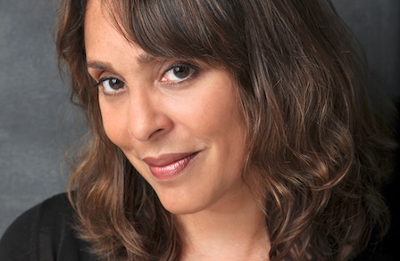
Natasha Trethewey (1966---
https://www.poetryfoundation.org/poems/47538/history-lesson-56d2280d442a7
https://www.poetryfoundation.org/poems/52891/flounder
Was twice a U.S. poet laureate, and was the poet laureate of Mississippi from 2012-2016
Notes:
Natasha Trethewey is mixed race: Her father was white, a Canadian college professor, her mother a social worker.

Slide 38
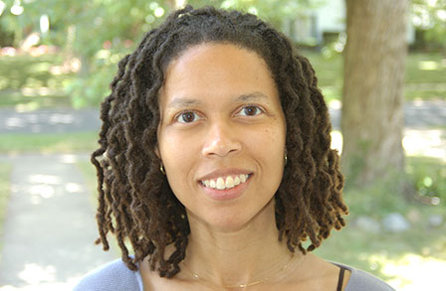
Evie Shockley (1965---- “anti-immigration”
https://www.poetryfoundation.org/poems/151252/anti-immigration-
Notes:
Evie Shockley “anti-immigration” Born and raised in Nashville, Tennessee, poet Evie Shockley earned a BA at Northwestern University, a JD at the University of Michigan, and a PhD in English literature at Duke University. This poem surprises with its evocation of a new North America returned to its earliest inhabitants. Evie Shockley

Slide 39
Danez Smith “summer somewhere”
https://www.poetryfoundation.org/poetrymagazine/poems/58645/from-summer-somewhere
Notes:
Danez Smith was born St. Paul, Minnesota. They are the author of Don't Call Us Dead (2017), a finalist for the National Book Award; [insert] Boy (2014), winner of the Lambda Literary Award and the Kate Tufts Discovery Award;

Slide 40
Justin Phillip Reed (1989--- https://www.poetryfoundation.org/search?query=justin+Phillip+Reed
Notes:
National Book Award for Poetry for Indecency (Coffee House Press, 2018)
Lambda Literary Award for Gay Poetry for Indecency (Coffee House Press, 2018)

Slide 41
“Portrait with stiff upper lip” by Justin Phillip Reed
Notes:
Portrait with stiff upper lip This poem takes stereotypes associated with Black men and spread them on the page, compelling us to read in different directions, up, down, diagonally, sideways.

Slide 42
Jericho Brown (1976--- (born Nelson Demery III)
https://www.poetryfoundation.org/poets/jericho-brown
BA Dillard University
MFA Univ. of New Orleans
PhD Univ. of Houston

