Slide 1
American slavery

Slide 2
Origins– indentured servitude
--Indentured servants arrive in Jamestown VA from Europe, including 20 Africans.
Indenture : people could promise 3 years of servitude in exchange for passage from Europe (mainly England).
Estimated 80-90% of the European settlers in VA were indentured
Life as an indentured servant was difficult.
Treatment was harsh.
When indenture ends, servants received land, tools and freedom.
Blacks and whites were treated equally in Tidewater (VA, MD); blacks could own land, and even have servants

Slide 3
Chronology
1619 The first 20 African indentured servants arrive in Virginia. Indenture mutated into enslavement. By 1690, every colony has enslaved people.
1793 Eli Whitney’s (1765 –1825) cotton gin increases the wish for enslaved people.
1808 Congress bans further importation of slaves.
1831 In Boston, William Lloyd Garrison (1805 – 1879) begins publication of the anti-slavery newspaper the Liberator
1831 – 1861 about 75,000 enslaved people escape North via the Underground Railroad. (see the film Harriet about Harriet Tubman) https://www.youtube.com/watch?v=GqoEs4cG6Uw
1846 Ex-slave Frederick Douglass (1818 – 1895) publishes the anti-slavery North Star newspaper.

Slide 4
Slavery in the Deep South-
1670-71 First settlers in Charleston came from Barbados, not from Europe.
Barbados was “the richest and most horrifying society in the English-speaking world” (Woodard, American Nations)
Wealth came from sugar cane.
Barbadian planters had treated indentured servants so badly that English poor avoided emigrating there.
Planters imported slaves from Africa and practiced chattel slavery.
Slave mortality was double the rate of Virginia.
Slaves were fixed possessions, slavery was inherited.

Slide 5
Triangle trade: the business of buying and selling human beings
https://www.youtube.com/watch?v=-M9Ux31AvWg

Slide 6
The Middle Passage
A slave ship might travel along the African coast accumulating its human cargo– people sold to traders or kidnapped.
Conditions were terrible: unsanitary, crowded
The voyage could take up to 3 months
Males were usually shackled to each other
Mortality estimated at 13%--from epidemics, dysentery, suicide, mutiny, bad weather, pirates

Slide 8
Experience of enslaved people
Tidewater – less harsh | Deep south– much harsher– to be “sold down the river” was a terrifying prospect
Enslaved population increased naturally | Higher mortality; Needed to keep importing slaves
Slaves to owners ratio 1:1.7 | Slaves to owners ratio 5:1
More stable African population | Less stable African population
Culture influenced by English culture | Afro-Caribbean culture evolved: Gullah, Creole, blues, jazz, gospel

Slide 9
Deep south harsh version of slavery spread
Caste society– can’t leave your caste
Blacks seen as “unclean,” subhuman
Mixing of castes was a tabu– violated with impunity by the masters who raped or seduced enslaved women (e.g. Sally Hemings and Thomas Jefferson; Margaret Garner)
Owners feared rebellion: enacted harsh laws to protect themselves and punish enslaved people who rebelled
Enslaved people were treated as property: bought and sold. Families were routinely broken up.

Slide 10
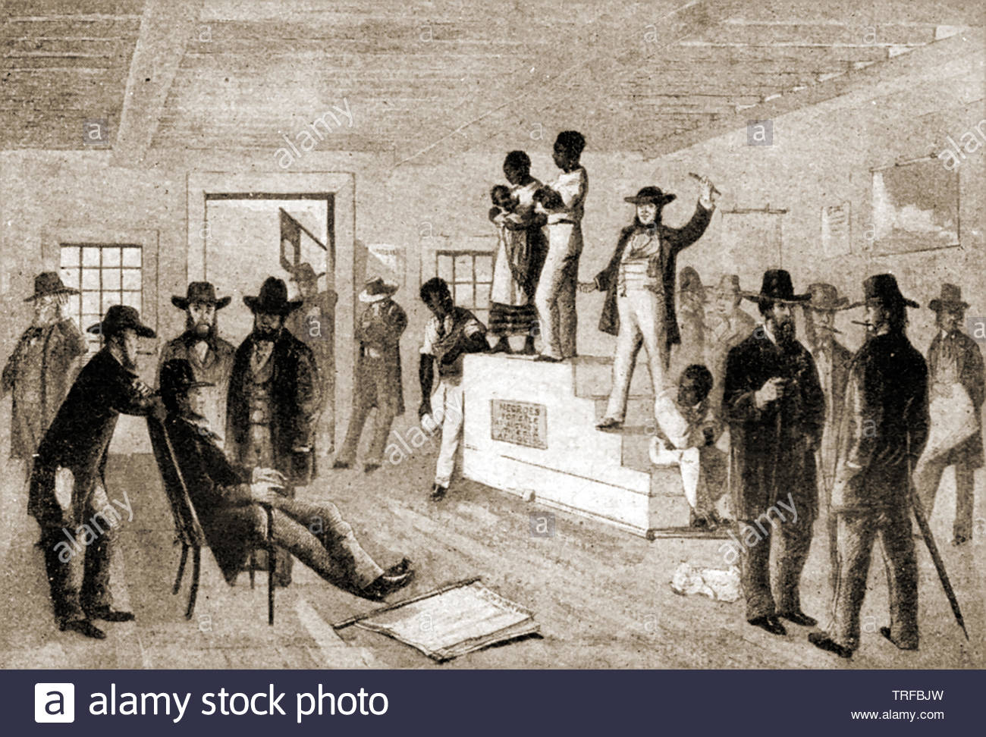
An auction of enslaved Africans

Slide 11
Slave Codes I
The most common elements are:
Movement Restrictions: Most regions required any slaves away from their plantations or outside of the cities they resided in to have a pass signed by their master
Marriage Restrictions: Most places restricted the marriage rights of enslaved people, ostensibly to prevent them from trying to change masters by marrying into a family on another plantation.^{[5]} Marriage between people of different races was also usually restricted.
Prohibitions on Gathering: Slave codes generally prevented large groups of enslaved people from gathering away from their plantations.

Slide 12
Slave Codes II
Slave Patrols: legal authority backed patrols by plantation owners and other free whites to ensure that enslaved people were not free to move about at night, and to generally enforce the restrictions on slaves.^{[6][7]}
Trade and Commerce by Slaves: Initially, most places gave enslaved people some land to work personally and allowed them to operate their markets. As slavery became more profitable, slave codes restricting the rights of enslaved people to buy, sell, and produce goods were introduced.^{[8]}

Slide 13
Slave Codes III
Punishment and Killing of Slaves: Slave codes regulated how slaves could be punished, usually going so far as to apply no penalty for accidentally killing a slave while punishing them.^{[10]} Later laws began to apply restrictions on this, but slave-owners were still rarely punished for killing their slaves.^{[11]} Historian Lawrence M. Friedman wrote: "Ten Southern codes made it a crime to mistreat a slave.... Under the Louisiana Civil Code of 1825 (art. 192), if a master was ′convicted of cruel treatment,′ the judge could order the sale of the mistreated slave, presumably to a better master."^{[12]}
Education Restrictions: Some codes made it illegal to teach slaves to read.^{[13}

Slide 14
Cotton

Slide 15
Rebellions
Stono Rebellion, 1739.
The New York City Conspiracy of 1741.
Gabriel’s Conspiracy, 1800.
German Coast Uprising, 1811.
Denmark Vesey 1822– he was executed before his plan could be carried out
Nat Turner’s Rebellion, 1831.
Wikipedia lists many more revolts
https://www.pbs.org/wnet/african-americans-many-rivers-to-cross/history/did-african-american-slaves-rebel/

Slide 16
South celebrates slavery
As the Deep South grew in wealth and power, its attitude changed after 1830 from viewing slavery as an embarrassment to celebrating slavery as part of their exalted culture. Their assertion:
“Theirs was a democracy modeled on the slave states of ancient Greece and Rome, whose elites had been free to pursue the finer things in life after delegating all drudgery to slaves and a disenfranchised lower class” (Woodard, p 202).

Slide 17
Underground Railroad

Slide 18
Fleeing

Slide 19
Slavery in the North
Slave trade– triangle trade was a source of wealth (the Brown family, the de Wolf family)
Slaves might be educated: Jupiter Hammon was a clerk in the shipping business of the Lloyd family (Lloyds of London); published first written poem by an African American
Phillis Wheatley was sent by her owners to England to organize publication of her first book of poetry.

Slide 20
Emancipation
September 22, 1862, President Abraham Lincoln issued the preliminary Emancipation Proclamation, which declared that as of January 1, 1863, all enslaved people in the states currently engaged in rebellion against the Union “shall be then, thenceforward, and forever free.”

