Slide 1
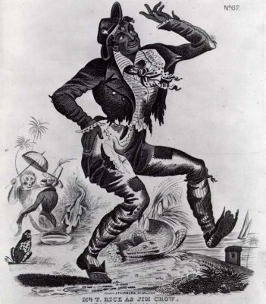
Jim Crow

Slide 2
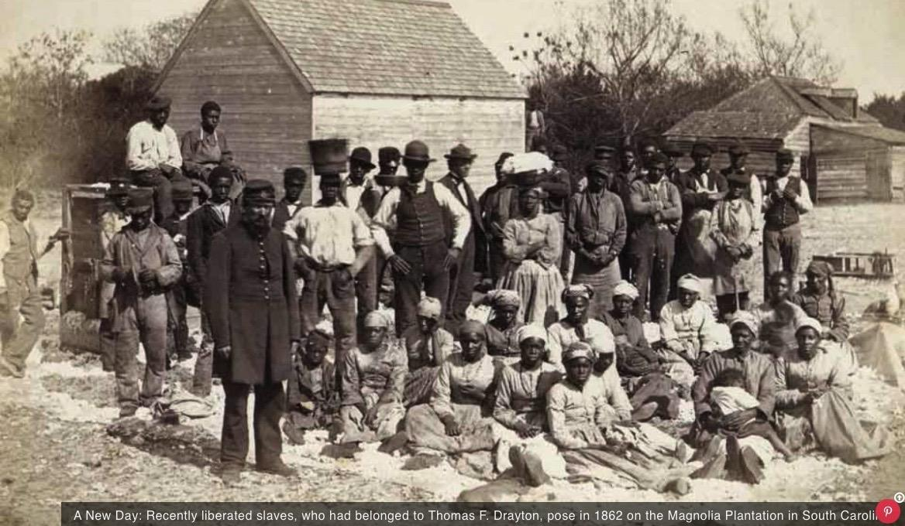
Freed Slaves

Slide 3
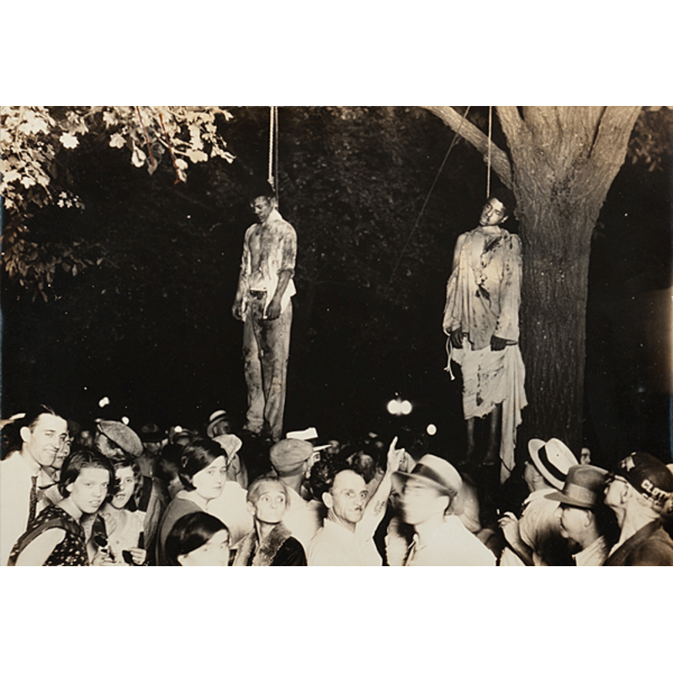
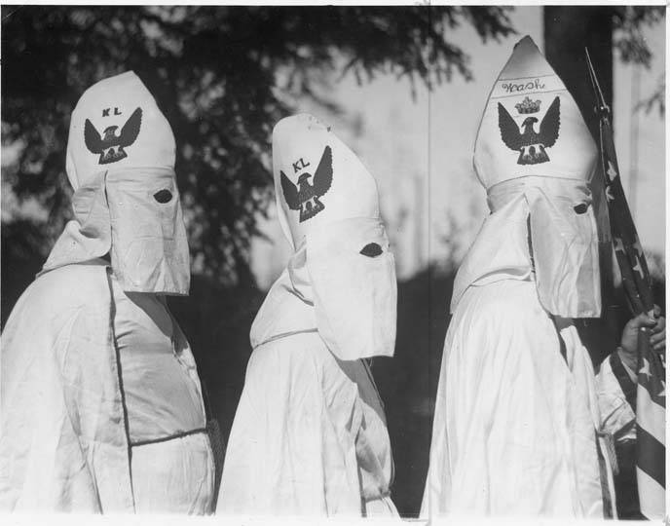
KKK and lynching:

Slide 4
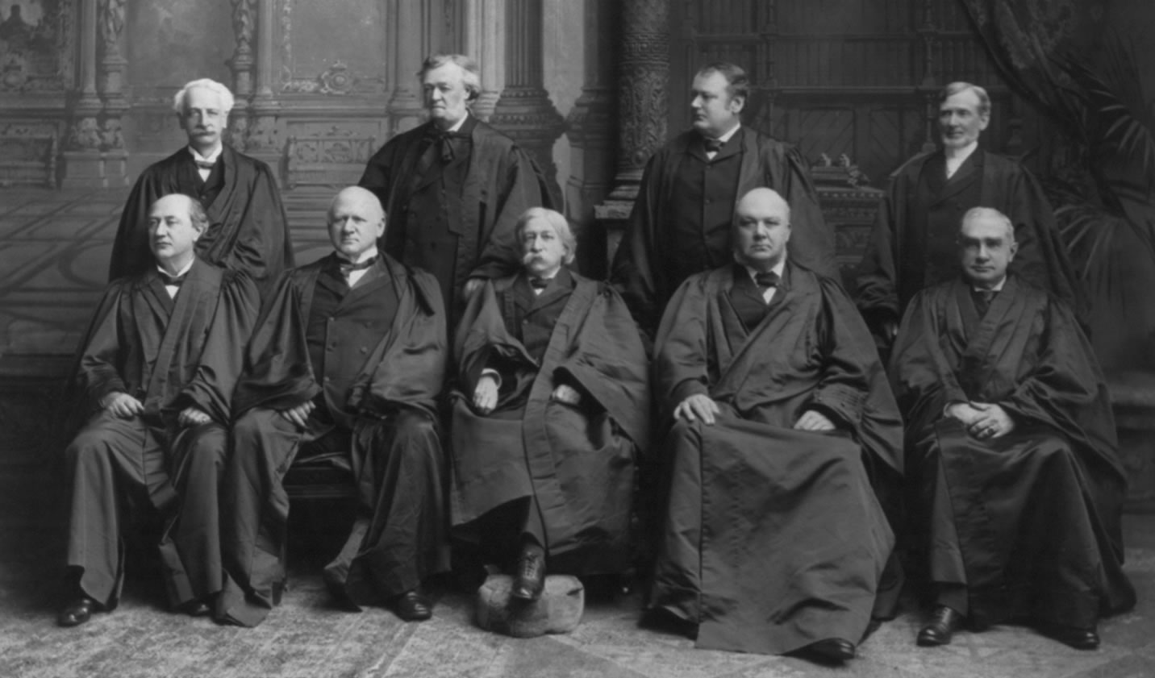
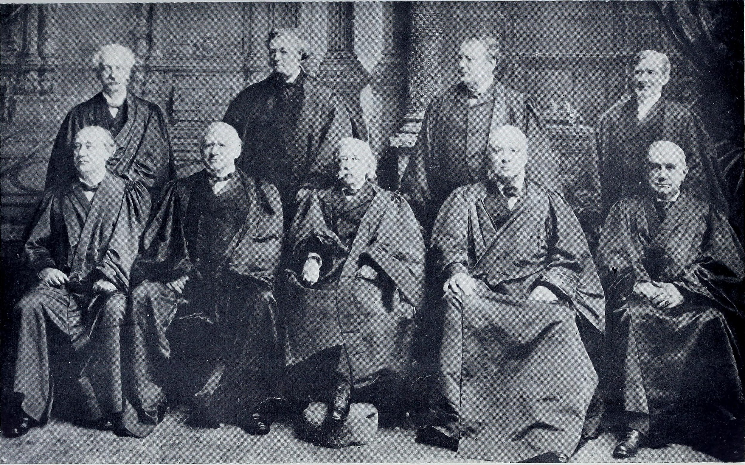

Slide 5
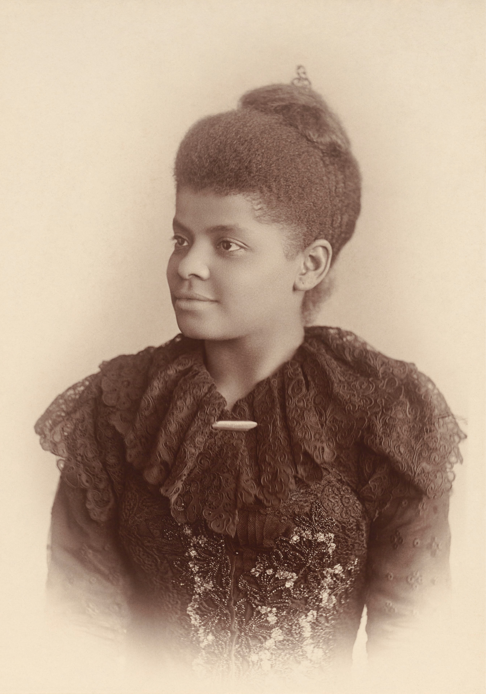
Ida B. Wells, 1862-1931

Slide 6
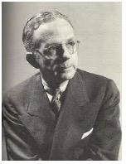
Walter White, 1893-1955

Slide 7
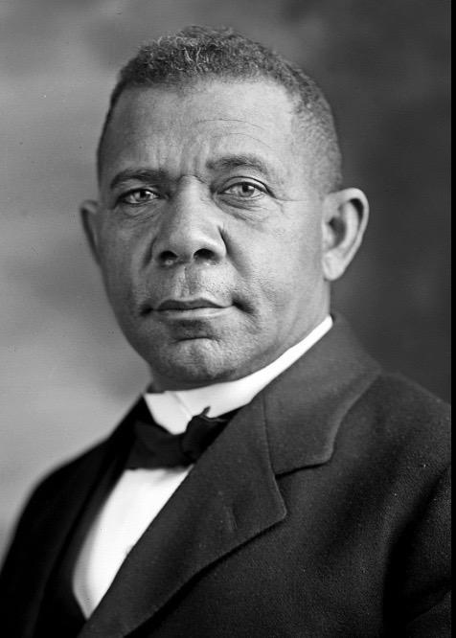
Booker T. Washington, 1856-1915

Slide 8
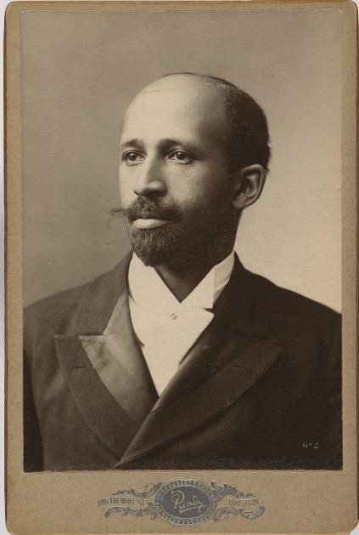
W. E. B. Du Bois, 1868-1963

Slide 9
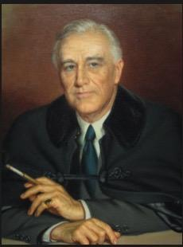
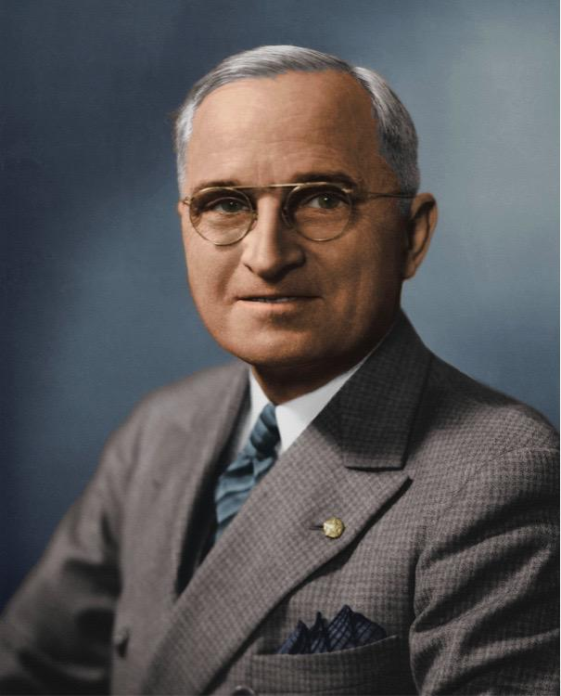
FDR and Harry Truman on Civil Rights:

Slide 10
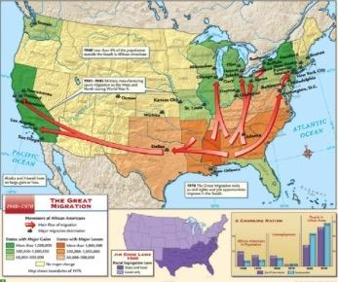
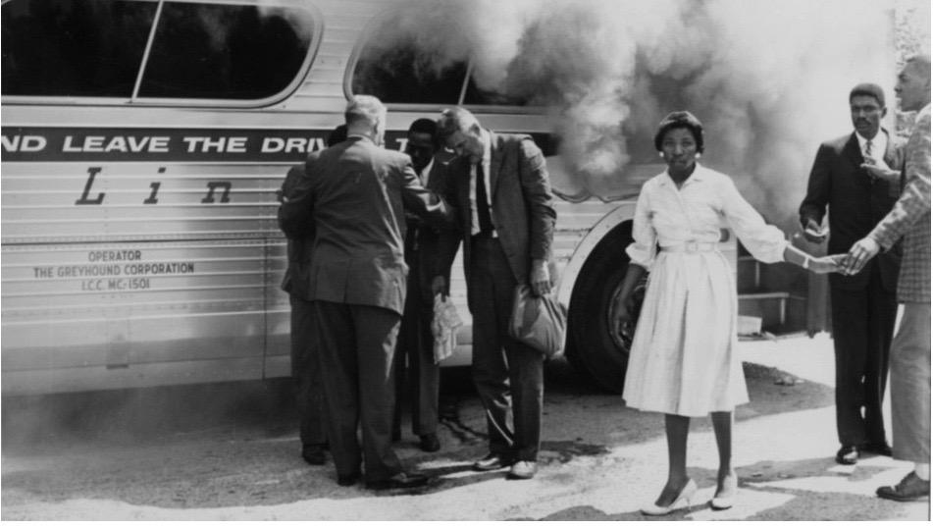
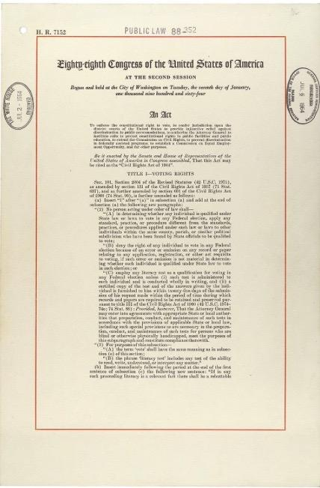
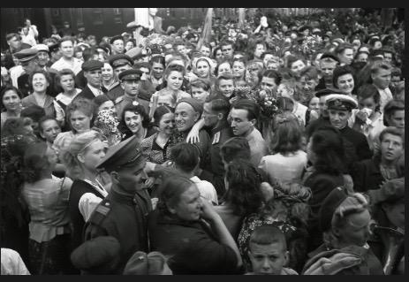
The End to Jim Crow?

Slide 11
1954: Brown v. Board of Education mandated ending discrimination in public schools.
1955: Emmett Till murder brought international attention to civil rights/lynching;
1955: Rosa Parks and the Montgomery bus boycott
1957: Martin Luther King, Jr., and Black pastors coordinated nonviolent protests; President Eisenhower sent federal troops to aid integration in Little Rock; Eisenhower signed Civil Rights Act
1960: 4 Black students in NC refused to leave “Whites-Only” lunch counter, inspiring other sit-ins. Armed federal troops escorted 6 year old into elementary school, inspiring a Norman Rockwell painting.

Slide 12
1961: Black and white freedom riders met with violence as they took bus trips through the South to protest segregated bus terminals, restrooms, lunch counters,
1963: 250,000 people marched on Washington; MLK’s “I Have a Dream” speech
1964: President Johnson signed Civil Rights Act.
1965: Malcolm X assassinated; Selma to Montgomery March met with police brutality; President Johnson signed Voting Rights Act.
1968: MLK assassinated; President Johnson signed Fair Housing Act.
. . . That could constitute the end of Jim Crow. . . but is it really over?

