Slide 1
Africa
Ideas of African in the Harlem Renaissance and beyond

Slide 2
Image of Africa in the Harlem Renaissance
Africa as a source of pride, a homeland, a place of origin
Poets and novelists wrote about Africa, basing their work on reading and imagination
Langston Hughes traveled in Africa; was disappointed that he was not welcomed as a brother; he was called “white”
http://nationalhumanitiescenter.org/tserve/freedom/1917beyond/essays/harlem.htm an essay by Trudier Harris

Slide 3
Back to Africa Movement
1803 England sends freed slaves to found Sierra Leone
1820 Freed slaves from the US found Liberia
Life in these countries was difficult: malaria; food shortages; tribal warfare; high mortality rate

Slide 4
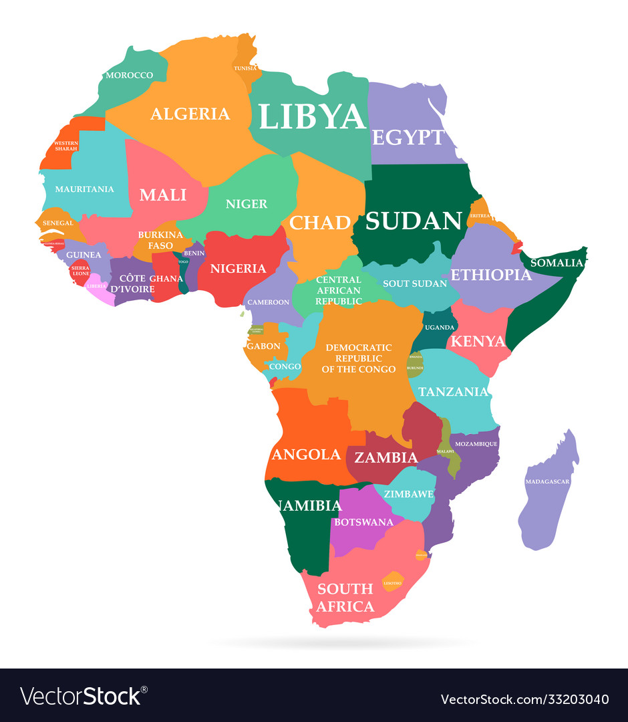
Africa

Slide 5
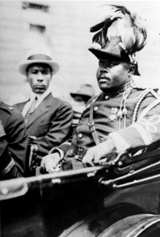
Marcus Garvey (1887-1940)
born in Jamaica
1916 moved to Harlem; agitated for a unified free Africa; for Blacks to return to Africa; allied with the Ku Klux Klan in advocating for racial separation; never went to Africa
1917 United Negro Improvement Association (UNIA) chapter in US
1919 Set up Black Star shipping line to take Blacks to Africa
Declared himself Provisional President of Africa
1927 Deported to Jamaica

Slide 6
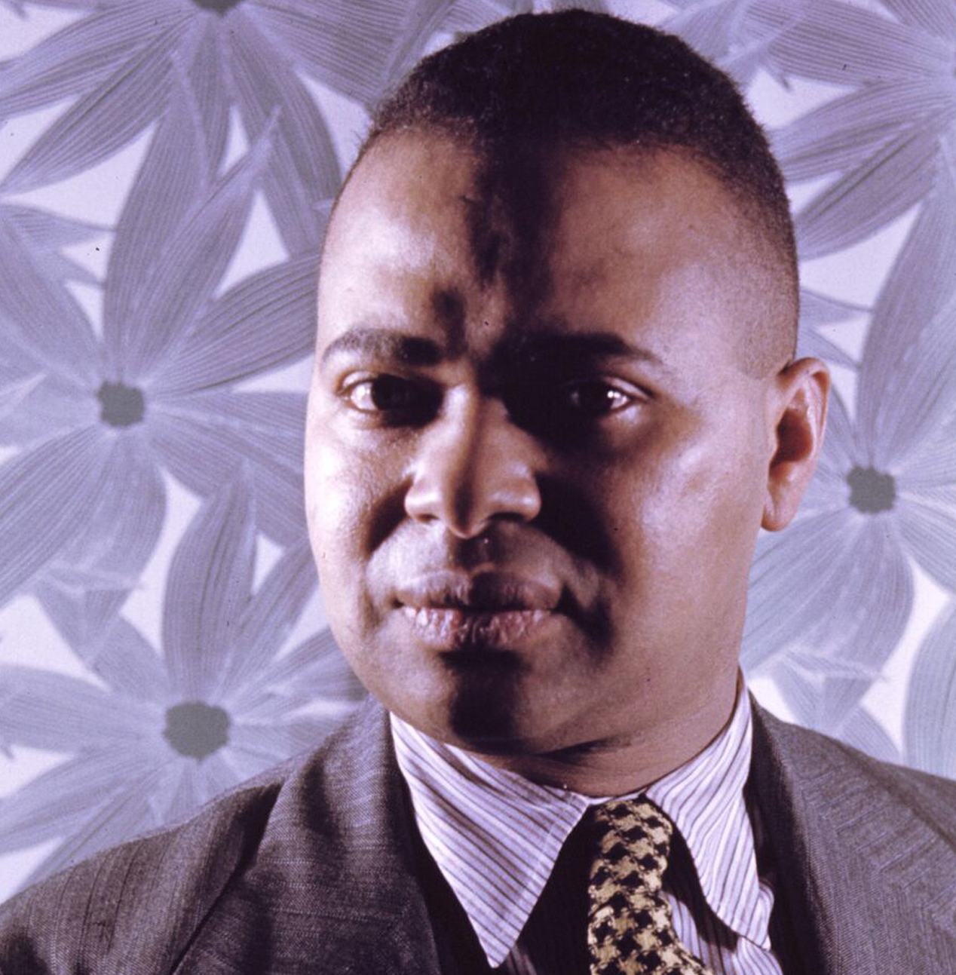
Countée Cullen (ne Porter) (1903-1946)
Heritage
What is Africa to me:
Copper sun or scarlet sea,
Jungle star or jungle track,
Strong bronzed men, or regal black
Women from whose loins I sprang
When the birds of Eden sang?
One three centuries removed
From the scenes his fathers loved,
Spicy grove, cinnamon tree,
What is Africa to me?
. . . . . .
Graduated from DeWitt Clinton HS in NY, and Phi Beta Kappa from NYU. MA from Harvard 1926.
Published his first book, Color, when he graduated.
He advised Black writers to follow white European and American traditions, rather than African.
He wrote sonnets, some of which we’ll see next week!
Notes:
Declined offers to teach in Southern Colleges, remained in Harlem. Raised by his grandmother after his parents died. When grandma died he was adopted by Rev. Frederick A. Cullen of the Salem African Methodist Episcopal Church in Harlem. In 1928 he married Nina Yolande DuBois, the daughter of W. E. B. DuBois, AND he received a Guggenheim Fellowship to write poetry in France. Although he advocated a universal model for poetry, rather than an ethnic one, his best poems foreground African American traditions.

Slide 7
Trochaic Tetrameter (unusual emphasis)
The meter of “Heritage”
Longfellow’s “Hiawatha”
On the shores of Gitche Gumee, Of the shining Big-Sea-Water, The witches in Shakespeare‘s Macbeth
Double, double, toil and trouble
Fire burn and cauldron bubble
Blake’s Tyger
Tyger, tyger burning bright
In the forests of the night

Slide 8
Heritage https://www.youtube.com/watch?v=UvN96fn5xTE&t=121s (Cullen reads up to second “What is Africa to me?”)
What are the speaker’s sources of information about Africa?
What features of Africa does the poem’s speaker include?
What is the speaker’s attitude toward Africa?
What are some poetic devices in the poem?

Slide 9
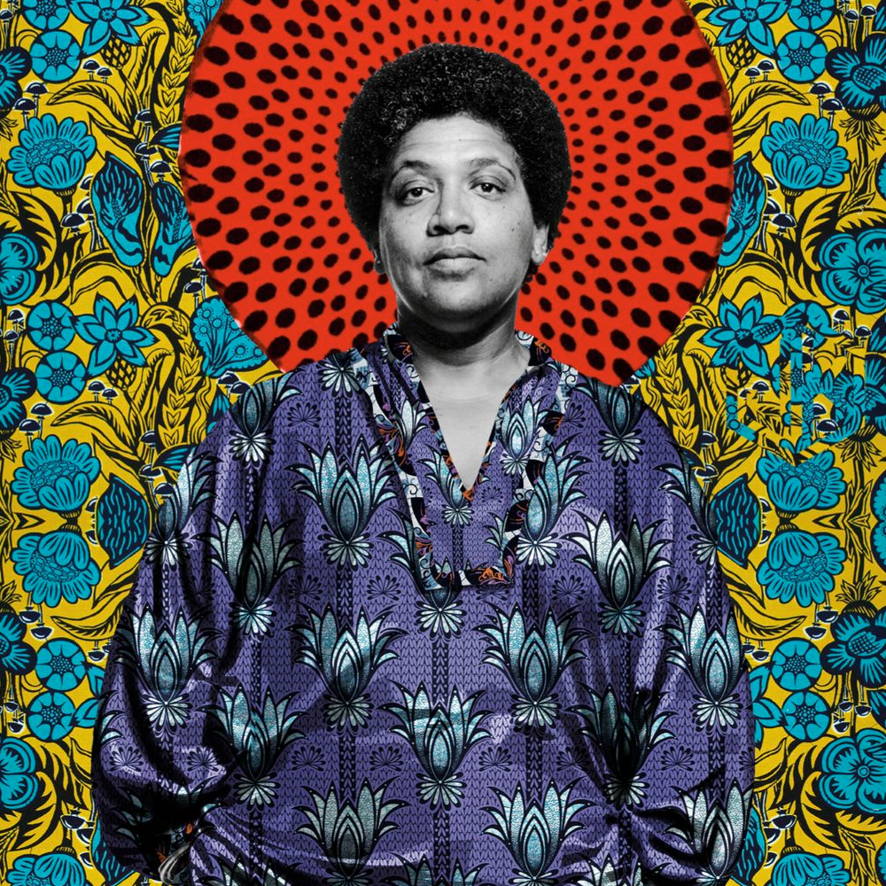
Audre Lorde (1934-1992)
“black lesbian socialist mother feminist warrior poet”
“and when we speak we are afraid our words will not be heard nor welcomed but when we are silent we are still afraid So it is better to speak remembering we were never meant to survive” ― Audre Lorde, “Litany for Survival”
The Black Unicorn: Poems

Slide 10
Life / Career– born 30 years after Cullen
Born in Harlem to parents who immigrated from Grenada
Worked on an assembly line in Mexico that exposed her to X-rays and carbon tetrachloride
1959 BA Hunter College (CUNY)
1961 MLIS Columbia University
1968 Writer-in-residence Tougaloo college, Mississippi
1968 taught in SEEK program at City College
Taught at John Jay College, Hunter College
1975 Five week trip to Africa
Authored 10 books of poetry, 4 of prose
1980 Founded kitchen table press with Barbara Smith
1991-1992. poet laureate of New York

Slide 11
Some links
Audre Lorde: Black Feminist Visionary and “Mytho-poet” by Njeng Eric Sipyinyu https://journals.openedition.org/lisa/2930
A Creative Use of African Sources by Andrea Benton Rushing https://www.jstor.org/stable/44489887
Adrienne Rich interview Audre Lorde (published in Signs vol 6, no. 4 Summer 1981, pp 713-736) https://www.jstor.org/stable/3173739

Slide 12
Kingdom of Dahomey

Slide 13
Warriors of Dahomey

Slide 14
Questions for “Heritage” and “125th St and Abomey”
How would you compare the settings of the 2 poems?
What are the speakers’ attitudes toward religion?
What questions does Africa appear to raise and / or answer in the 2 poems?
Would you include either / both of these poems in your anthology?

