Slide 1
Countée Cullen
“to make a poet black” https://www.youtube.com/watch?v=XKAuuMl9gHs

Slide 3
Time Line
1903 born– (NY?) Louisville, KY Countée LeRoy Porter
1917 attends DeWitt Clinton H.S., NY – wins public speaking and poetry contests; earns excellent grades; vice President of his class
1917 lives with (maybe adopted by) Frederick Asbury Cullen, pastor of Salem Church in Harlem
1922 –1925 Attends NY University– becomes friends with Alain Locke, Langston Hughes, Harold Jackman and others
1925 Publishes Color
1926 MA Harvard
1926-27 prose column The Dark Tower for the magazine Opportunity
1927 publishes Copper Sun; The Ballad of the Brown Girl (poems);
1927 edits Caroling Dusk: An Anthology of Verse by Negro Poets

Slide 4
Time Line (2)
1928 –1929 marries Nina Yolande DuBois (daughter of W.E.B. DuBois)
1928 Guggenheim Fellowship
1929 Black Christ (poems)
1932 One Way to Heaven (novel)
1934 Teaches English and French at Frederick Douglass Jr. High
1940 The Lost Zoo (children’s book, co-authored by Christopher Cat)
1940 Marries Ida Roberson
1942 My Lives and how I Lost Them (Christopher Cat)
1946 Cullen dies

Slide 5
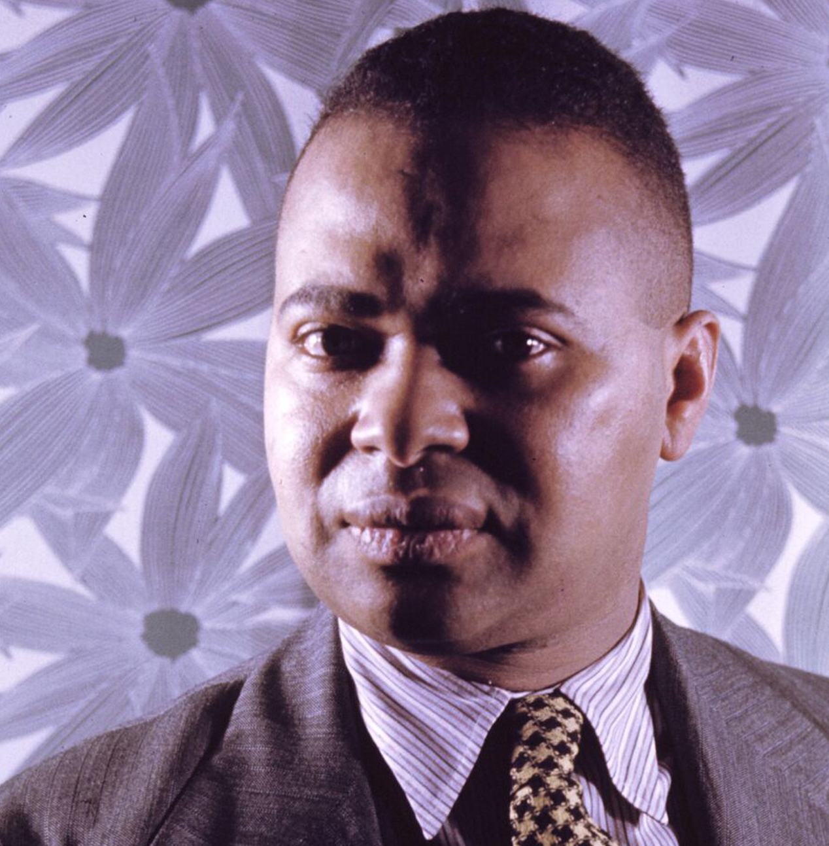
Countée Cullen (ne Porter) (1903-1946)
Heritage
What is Africa to me:
Copper sun or scarlet sea,
Jungle star or jungle track,
Strong bronzed men, or regal black
Women from whose loins I sprang
When the birds of Eden sang?
One three centuries removed
From the scenes his fathers loved,
Spicy grove, cinnamon tree,
What is Africa to me?
. . . . . .
Graduated from DeWitt Clinton HS in NY, and Phi Beta Kappa from NYU. MA from Harvard 1926.
Published his first book, Color, when he graduated.
He advised Black writers to follow white European and American traditions, rather than African.
He wrote sonnets, some of which we’ll see next week!
Notes:
Declined offers to teach in Southern Colleges, remained in Harlem. Raised by his grandmother after his parents died. When grandma died he was adopted by Rev. Frederick A. Cullen of the Salem African Methodist Episcopal Church in Harlem. In 1928 he married Nina Yolande DuBois, the daughter of W. E. B. DuBois, AND he received a Guggenheim Fellowship to write poetry in France. Although he advocated a universal model for poetry, rather than an ethnic one, his best poems foreground African American traditions.

Slide 6
On Poetry
Cullen based his work on white models and traditions. He believed that African American writers should avoid negative images of blacks (he argued that Langston Hughes should not write about jazz). Yet Cullen’s 3 most –anthologized poems deal with black subject matter (“Incident,” “Yet do I Marvel,” and “Heritage.”)
“If I am going to be a poet at all, I am going to be POET and not NEGRO POET…. [Not going to write propaganda] .. Of course when the emotion rising out of the fact that I am a negro is strong, I express it” (Interview for newspaper article).
“James Weldon Johnson may be perfectly right … about my being at my best in racial poems… were I criticizing my own work, I should condemn myself from that standpoint” (Letter to Harold Jackman)

Slide 7
Reading of the poem
https://www.youtube.com/watch?v=XKAuuMl9gHs
https://www.youtube.com/watch?v=OxPpHH3L3n0 (Al Filreis’s seminar)

Slide 8
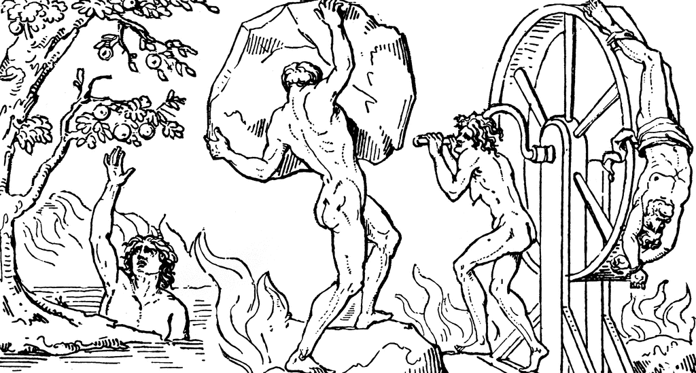
Sisyphus, Tantalus, and Ixion

Slide 9
Questions about “Yet do I Marvel”
Who are Tantalus and Sisyphus? What are their stories? Why are they in this poem? And why a mole?
What are some of the poetic devices in this sonnet?
What is the tone of the poem?
What issue(s) does Cullen address here?
Rampersad did not include this poem in the Oxford anthology. Would you include it if you were compiling an African American poetry collection? Why?

