Slide 1
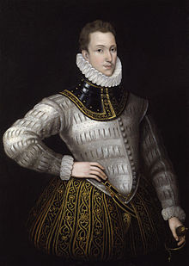
Sir Philip Sidney, 1554 – 1586
Renaissance Man
Courtier
Scholar
Soldier
Essayist, Novelist, Poet
1581 - 1585
The Defence of Poesy
The Arcadia
Astrophel and Stella

Slide 2
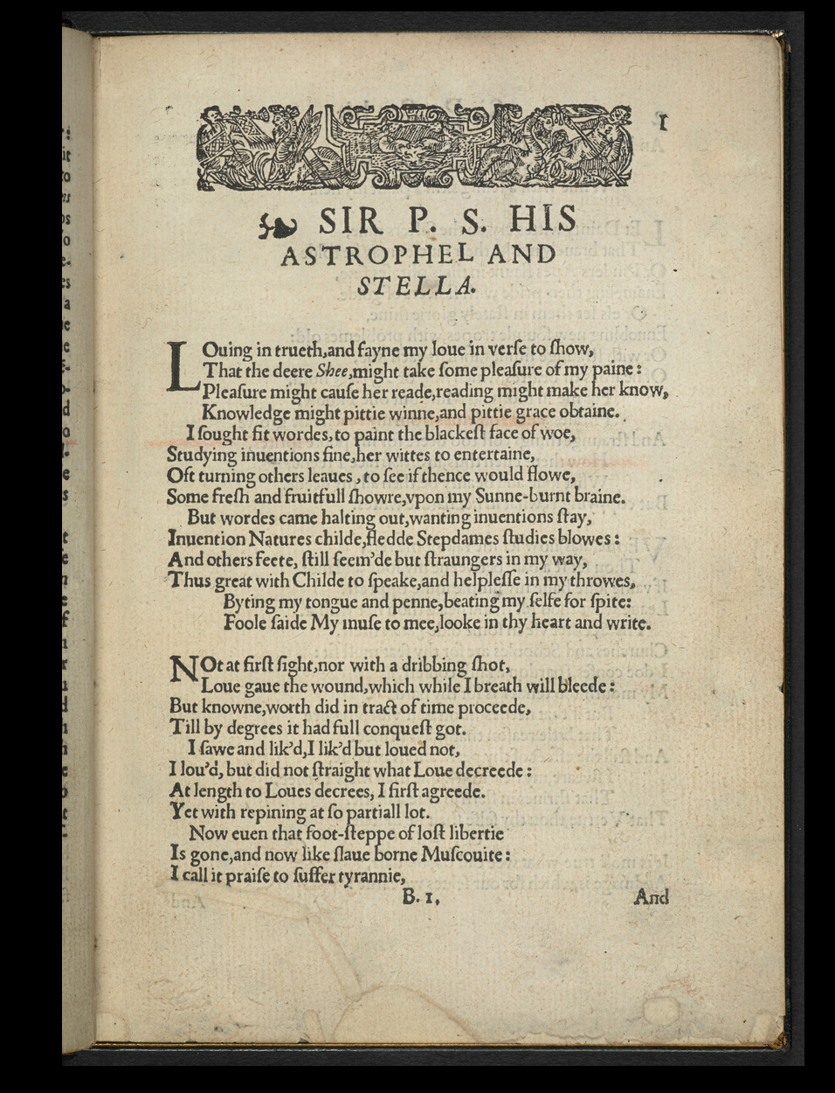
Astrophel and Stella – Sonnet Sequence
1582, 1591, 1598
Contains 108 sonnets, 11 songs.
Follows a narrative sequence
Presents invented characters
Adapted Petrarchan Sonnet form into English form
Added varieties of of emotion from poem to poem Retained philosophical meditations
Added thoughts on the act of poetic creation

Slide 3
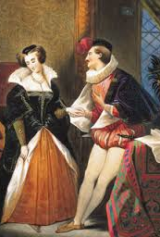
Courtly love poetic conventions
The speaker(male) expresses his feelings about the woman loves so deeply that he is heartsick.
The beloved (female) is unresponsive and unattainable.
The beloved is exquisitely beautiful and absolutely virtuous.
As a result: The poet is almost paralyzed with despair.
The subjects of these poems:
The nature of true, enduring love
Platonic love can lead to moral goodness and wisdom
Methods, purposes and power of poetry
Power of poetry to overcome the ravages of time and death

Slide 4
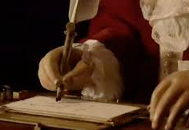
Quick review of sonnet structure
14 lines; subject traditionally love
English / Elizabethan / Shakespearean:
3 quatrains
Volta: Turn in the final couplet
Epigrammatic.
Iambic pentameter
Poetic devices: puns, paradox, personification, similes, metaphors

Slide 5
What is the persona of the speaker of these poems? In which details does he come to life? How does the tone or moods of these sonnets contribute to that persona?
In what ways to these 4 poems conform to the conventions of courtly love and in what ways do these sonnets push against these conventions?
Is it possible to appreciate these 4 poems without knowing the conventions of courtly love?
In what ways do these sonnets conform to the features of the English sonnet and in what ways do these sonnets push against those conventions?
Sidney wrote these poems for friends and family. They were not published in his lifetime. How might these circumstances have shaped the nature of these poems or Sidney’s motives as a poet?

