Slide 1
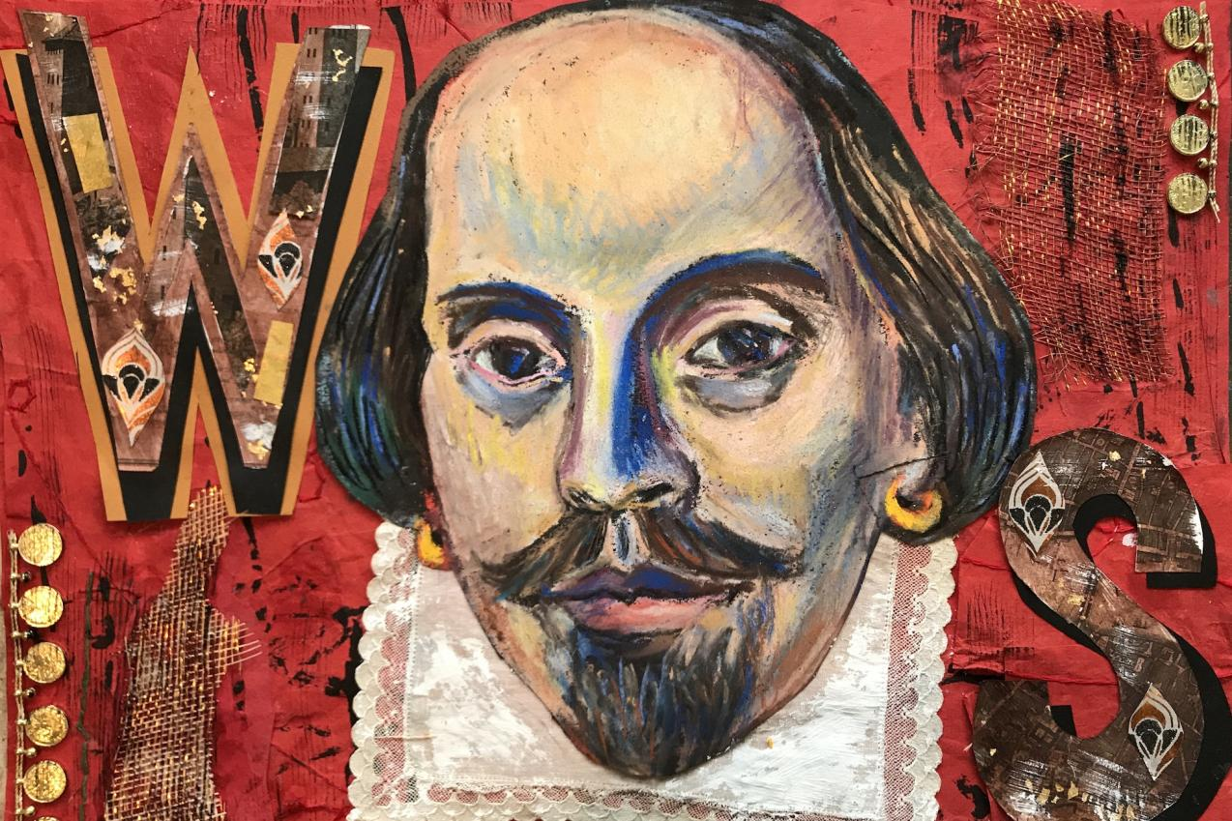
Shakespeare 1564-1616

Slide 2
Biography
Father
a glove-maker and minor town official
Shakespeare
Attended grammar school
Married Ann Hathaway at age 18
Moved to London
Actor and playwright
Became wealthy

Slide 3
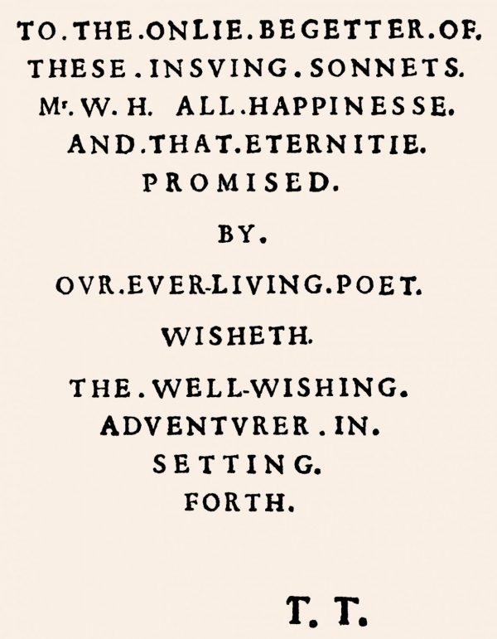
Sonnet Dedication

Slide 4
The sonnets
Published in 1609
154 sonnets
First 126 written to / about a “fair young man”
Last sonnets written to /about a “dark lady”

Slide 5
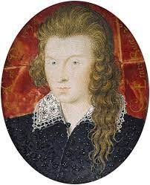
Henry Wriothesley, 3rd Earl of Southampton (1573-1624) painted by Nicholas Hilliard at age 21. The “fair youth” of the sonnets?

Slide 6
Patronage system
Patron comes from the Latin “Pater” or father
Wealthy aristocrats financed playwrights, poets, artists, musicians
Patrons provide financial support and social support
Shakespeare had several patrons, among them Wriothesley

Slide 7
The “dark lady” sonnets
The subject
not the typical fair lady of the courtly lover
the poet is not pining for her
The tone
often more sexual

Slide 8
Who was the “dark lady” of the sonnets?
A dark-haired woman?
A woman with a dark complexion?
A woman of color?
A woman with a dark reputation?
Did Shakespeare have a relationship with this woman?
Was she a real person?

